Slide 1
October Down Day
Civil Air Patrol
One Civil Air Patrol, excelling in service to our nation and our members!

Slide 2
Overview
Commander’s Intent: Major General Mark Smith
Introduce/Review the Five Pillar Model
How we will use the model for Stress and Resilience
Importance of Suicide Awareness
Tools: Know the signs, ACE, Hotlines
Notes:
2

Slide 3
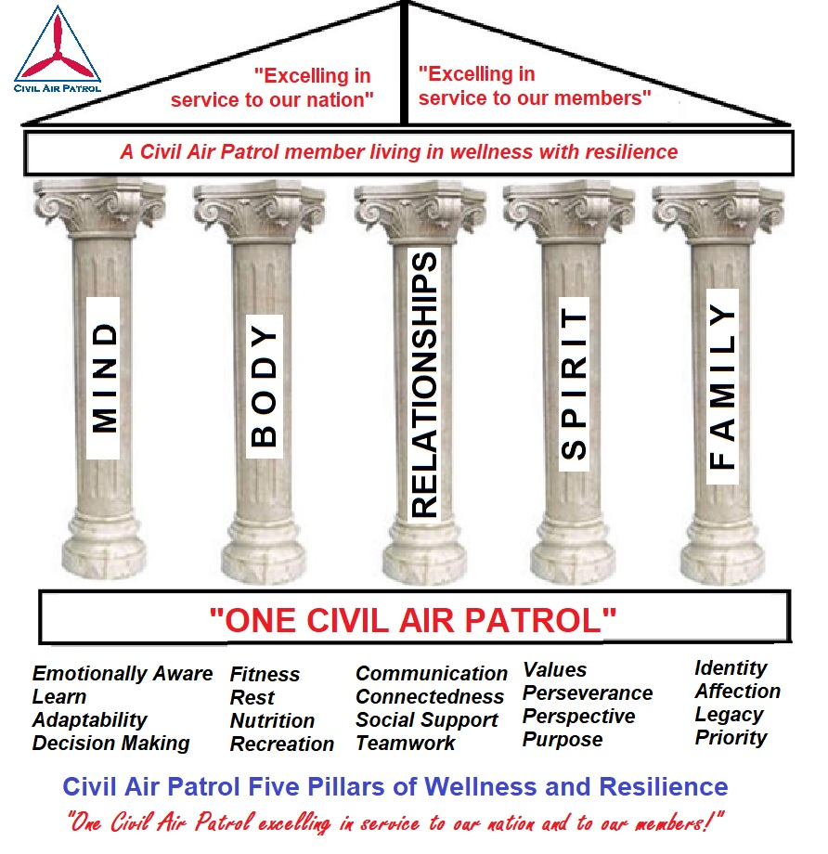
Five Pillars
Five Pillars of Wellness and Resilience
Notes:
3

Slide 4
What Is Wellness?
Five Pillars of Wellness and Resilience
“The five pillars are Mind, Body, Relationships, Spirit, and Family. They represent the focus areas that contribute to our personal level of “wellness.” This personal wellness enables us to operate at our best, sustaining us during times of stress and making us resilient to the difficulties of life. This helps us to be successful as CAP Volunteer Airmen.” (Maj. Gen. Mark Smith)
Notes:
4

Slide 5
What Is Wellness?
“Wellness” is living with good “habits” so that we are equipped to achieve personal excellence, sustaining us during times of stress and making us resilient to the difficulties of life.
Notes:
5

Slide 6
What Is Wellness?
“For more information on the Five Pillars of Wellness and Resilience, visit the webpage at:
bit.ly/CAP5Pillars
Notes:
6

Slide 7
Stress and Resilience
Stress is our reaction to change. Some stress is good.
When changes accumulate or put “pressure on us,” or when one of the pillars experiences a very radical change or disruption, CRISIS occurs. At this point we feel “PAIN” (mental or physical or emotional).
When the “pain” seems unbearable, some people may want to take drastic measures to stop it. They may want to end their life.
Notes:
7

Slide 8
Suicide Awareness
“How big is this problem? Why are we concerned?”
Notes:
8

Slide 9
Suicide Awareness
What are some groups that we think might be at higher-risk for suicide? Which one of the Five Pillars is “under stress” in these individuals?
Notes:
9

Slide 10
Suicide Awareness
People with Mental illness (including PTSD) - MIND
Youth who are bullied by peers - RELATIONSHIPS
Alaska Native and Native American - RELATIONSHIPS
People with Relationship Problems - RELATIONSHIPS
People with Financial Problems - (multiple)
People with Substance Abuse Problems - BODY
LGBTQ Youth - RELATIONSHIPS
People with a serious illness - BODY
Notes:
10

Slide 11
Suicide Awareness
“Suicide does not discriminate. People of all genders, ages, and ethnicities can be at risk. Suicidal behavior is complex and there is no single cause.”
Notes:
11

Slide 12
Suicide Awareness
WARNING SIGNS
Talking about wanting to die or wanting to kill themselves
Talking about feeling empty, hopeless, or having no reason to live
Making a plan or looking for a way to kill themselves, such as searching online, stockpiling pills, or buying a gun
Talking about great guilt or shame; extreme self-hating thoughts
Talking about feeling trapped or feeling that there are no solutions
Notes:
12

Slide 13
Suicide Awareness
WARNING SIGNS
Feeling unbearable pain (emotional pain or physical pain)
Talking about being a burden to others
Using alcohol or drugs more often
Acting anxious or agitated
Isolation from friends and loved ones
Notes:
13

Slide 14
Suicide Awareness
WARNING SIGNS
Changing eating and/or disrupted sleep patterns
Showing rage or talking about seeking revenge
Taking great risks that could lead to death, such as driving extremely fast
Talking or thinking about death often
Displaying extreme mood swings, suddenly changing from very sad to very calm or happy
Notes:
14

Slide 15
Suicide Awareness
WARNING SIGNS
Giving away important possessions
Saying goodbye to friends and family
Putting affairs in order, making a will
Does anyone have any thoughts about Warning
Signs that they would like to share?
Notes:
15

Slide 16
Suicide Intervention
Three Steps of “ACE” to help your friend, and save a life.
Step 1: ASK. Ask your friend, “Are you thinking of killing yourself?” It’s a tough question, but you need to ask it.
Step 2: CARE. Show your friend you care by taking them to a safe place, and listening to whatever it is they have to say. Don’t be judgemental, or too quick to give advice. Most of the time, people just need to say what they are thinking and feeling out loud.
Step 3: ESCORT. If your friend gave any hint that they are thinking of killing themselves, call 911 or take them to the Emergency Room. For counseling or guidance, bring them to a chaplain, mental health professional, or a supervisor. NO MATTER WHAT, escort your friend to some sort of help. Do not leave your Wingman alone.
Notes:
16

Slide 17
Suicide Intervention
Tools
The National Suicide Prevention Lifeline provides 24/7, free and confidential support for people in distress, prevention and crisis resources for you or your loved ones, and best practices for professionals. Their phone number is 1-800-273-8255.
The Spanish Language Lifeline phone number is 1-888-628-9454.
If someone is in crisis, and cannot make a phone call for support, there is also the Crisis Text Line.
Every texter is connected with a Crisis Counselor, a real-life human being trained to bring texters from a hot moment to a cool calm through active listening and collaborative problem solving. All of Crisis Text Line's Crisis Counselors are volunteers, donating their time to helping people in crisis. The number to Text is 741741.
Notes:
17

Slide 18
Suicide Intervention
What local resources are there in our area?
What can we do as a CAP unit to support our members?
Notes:
18

Slide 19
Conclusion
Thank you for participating in today’s lesson.
MIND BODY RELATIONSHIPS SPIRIT FAMILY
Notes:
19

