Slide 1
Physical Wellness
A Focus on the Pillar of the Body
October 2019 Wingman Resilience Day

Slide 2
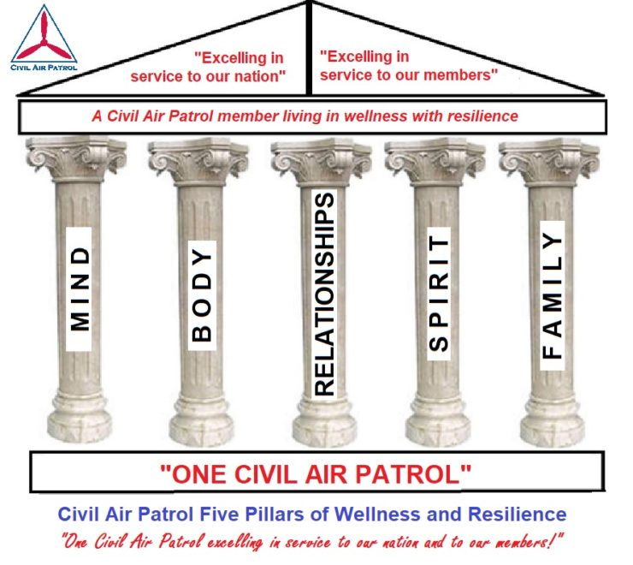
The 5 Pillars
The Pillar of BODY includes:
Physical fitness
Rest
Nutrition
Recreation

Slide 3
Overview
Why discuss physical wellness?
Fitness
Cadets
Senior Members
Recreation
Nutrition
Rest
Debrief
Ongoing Activities

Slide 4
Why Discuss Physical Wellness?
This is one of CAP’s 5 Pillars of Wellness and Resilience
https://capchaplain.com/resources/wellness/
We want to provide our Airmen and their Wingmen with the resources to live better
Our members are the single most important resource in the Civil Air Patrol
This next year our focus will be on the Pillar of the Body
While every pillar in the model is a source of “personal strength,” it is the Pillar of Body that provides the literal strength to thrive

Slide 5
Physical Fitness
“the ability to carry out daily tasks with vigor and alertness, without undue fatigue, and with ample energy to enjoy leisure-time pursuits and respond to emergencies.”
(Centers for Disease Control and Prevention)
“Physical fitness is not only one of the most important keys to a healthy body, it is the basis of dynamic and creative intellectual activity.”
(John F. Kennedy)

Slide 6
Health Benefits of Physical Activity
Participating in an appropriate level of physical activity can prevent:
1 in 10 premature deaths
1 in 8 cases of breast cancer
1 in 8 cases of colorectal cancer
1 in 12 cases of diabetes
1 in 15 cases of heart disease
The health benefits of physical activity:
Are generally independent of body weight
Span all ethnicities and genders
Outweigh the risk of injury and heart attacks during the activity

Slide 7
Aspects to Fitness Regimens
Cadet Physical Fitness Program | Senior Member Fitness Recommendations
Activities | Identifying Needs & Recognizing Importance
Academics | Finding Time
Attitude | Goal Setting
Assessment | Using Resources
Awards | Partnering for Success

Slide 8
Cadet Physical Fitness Program
Activities
Get moving!
The heart of the cadet fitness program is activities
Cadets will experience a range of fun, structured activities at squadron meetings and weekend events

Slide 9
Cadet Physical Fitness Program
Academics
To get the most benefit from the program it's important that cadets understand the concepts of fitness, training, nutrition, lifelong wellness, and more
Cadets learn about these ideas in both classroom and hands-on lessons, then put them into action in their daily lives

Slide 10
Cadet Physical Fitness Program
Attitudes
Cadets develop a positive attitude toward and relationship with fitness through the support of their squadron and their peers
New cadets start by working with a fitness mentor, and then become the mentors themselves

Slide 11
Cadet Physical Fitness Program
Assessment
To plan where you're going, you have to know where you are
A quarterly fitness test will help cadets identify current fitness levels for personal goal setting and progress evaluation
This is what some CAP members think the entire Cadet Physical Fitness Program is… but there’s so much more!

Slide 12
Cadet Physical Fitness Program
Awards
Celebrate cadets' efforts with a variety of awards
Different awards recognize every level of fitness at each echelon of the program
Also check out the Presidential Champions!, http://fitness.foundation/presidential-champions

Slide 13
Recommendations for Physical Activity:
School-Aged Children and Adolescents (6-17)
60 minutes of physical activity daily at a moderate to vigorous intensity level
Aerobic: Moderate- or vigorous-intensity aerobic physical activity and should include activity on at least 3 days a week
Muscle-strengthening: As part of the 60 minutes or more of daily physical activity, on at least 3 days a week
Bone-strengthening: As part of the 60 minutes or more of daily physical activity, on at least 3 days a week

Slide 14
Senior Member Fitness Recommendations
All Airmen in CAP can consider options for improving their everyday lives
Take a look at the handouts and tips provided, and make the best decision that works for YOU

Slide 15
Senior Member Fitness Recommendations
Identify Needs
This might best be accomplished together with your personal health care provider
Increasing physical wellness might help Airmen have:
Increased mission readiness because of reduced illness
Improved morale and likely improved scores on the command climate
Improved work products that are typically completed in a shorter time period
Reduced periods of minor illness (e.g. “common colds”)
Improved concentration because of increased activity
Weight reduction which can result in the reduction of blood pressure, the reduction in blood sugar, and the reduction of risk for having a heart attack or stroke

Slide 16
Senior Member Fitness Recommendations
Find Time
We live in a culture that places a lot of demands on each of us
Even if you cannot dedicate consecutive hours several times a week, you may be able to make adjustments that can help increase physical wellness
Refer to the Physical Wellness Sample Schedule for ideas, or work with a wingman to come up with what’s right for your situation

Slide 17
Senior Member Fitness Recommendations
Set Goals, SMART goals can work here
Specific
Consider a certain number of steps each day, or a certain number of crunches
Don’t try to “be more fit” or “work out more”
Measurable
Use metrics you can track, steps, repetitions, miles, minutes, etc.
Achievable
This is personal to you, but remember… start as slowly as you need to
A “couch-to-5K” or similar plan takes time, don’t rush and hurt yourself
Relevant
Ensure your goals will actually meet your needs
Time-Bound
Give yourself a reasonable deadline to make progress

Slide 18
Senior Member Fitness Recommendations
Use Resources
Healthcare provider
Local fitness center
Online tutorials (research the quality of the publisher)
CAP Health Service Officer
Your wingman

Slide 19
Senior Member Fitness Recommendations
Partner for Success
Check in with a wingman to discuss your goals and progress
You’re setting your own personal goals, but you’re not alone!
Friendly competition and accountability partnerships can help you stay motivated

Slide 20
Recommendations for Physical Activity:
For adults (18+)
The equivalent of 150 to 300 minutes of moderate-intensity aerobic physical activity each week, or 75 to 150 minutes of vigorous-intensity aerobic physical activity
Adults also need muscle-strengthening activity at least 2 days each week
Health benefits increase if individuals participate in >300 minutes of aerobic physical activity per week

Slide 21
Fitness Activity
Using the Daily Flexibility Program handout, let’s do some stretching now!
Use ORM to ensure this can be done safely
Spend 5 minutes stretching out individually, or as a group

Slide 22
Recreation
“Refreshment of strength and spirits after work”
(Merriam-Webster’s Dictionary)
“If bread is the first necessity of life, recreation is a close second”
(Edward Bellamy)
“People who cannot find time for recreation are obliged sooner or later to find time for illness.”
(John Wanamaker)

Slide 23
Health Benefits of Recreation
Creating, improving and promoting places to be physically active can result in a 25 percent increase of residents who exercise at least three times per week and improve individual and community health (CDC)
Nearly half of individuals who participate in recreation several times a week state that they are “completely satisfied with the quality of their lives,” compared to just one quarter of nonparticipants (ARC)

Slide 24
The difference between leisure and recreation
Source: https://us.humankinetics.com/blogs/excerpt/definitions-of-leisure-play-and-recreation, Table 1.1
Concept | Definition
Leisure as time | Leisure is time free from obligations, work (paid and unpaid), and tasks required for existing (sleeping, eating).
Leisure as activity | Leisure is a set of activities that people engage in during their free time-activities that are not work oriented or that do not involve life maintenance tasks such as housecleaning or sleeping.
Leisure as state of mind | Leisure depends on a participant’s perception. Perceived freedom, intrinsic motivation, perceived competence, and positive affect are critical to the determination of an experience as leisure or not leisure.
Play | Play is imaginative, intrinsically motivated, nonserious, freely chosen, and actively engaging. Play is typified by spontaneity, joyfulness, and inhibition and is done not as a means to an end but for its inherent pleasure.
Recreation | Recreation is an activity that people engage in during their free time, that people enjoy, and that people recognize as having socially redeeming values. The activity performed is less important than the reason for performing the activity, which is the outcome.
Source: https://us.humankinetics.com/blogs/excerpt/definitions-of-leisure-play-and-recreation, Table 1.1

Slide 25
Types of Recreational Activities
Individual or Group | Organizational
Can be performed on one’s own or within a group. These are loosely structured and participation is organized by the individual | Independent Groups or Organizations develop programs which individuals can join to participate in an organized recreational activity
Examples: Arts and Crafts, Music, Dancing, Museums, Reading, Games, Travel, Hiking, Camping, Biking, Sailing, Skiing, Volunteering | Non-profit examples: Civil Air Patrol, Boys and Girls Club of America, YMCA, National Recreation and Park Association
 | For-profit examples: gyms, spas, sports teams, dance troupes, social groups

Slide 26
Recreation Activity
As an ice-breaker, we thought about different recreation activities that we have or wish to participate in
Let’s discuss the activities that were brought up earlier, and why they might be beneficial

Slide 27
Recreation Final Thoughts
As individuals, we should strive to participate in recreational activities that meet our needs for physical and mental wellness
We can meet these needs through participation in a variety of individual and community-based activities
Recreation is an important part of our wellness needs

Slide 28
Rest
“Sleep hygiene is a variety of different practices and habits that are necessary to have good nighttime sleep quality and full daytime alertness.”
(The National Sleep Foundation)
"Sleep is that golden chain that ties health and our bodies together."
(Thomas Dekker)
"A good laugh and a long sleep are the best cures in the doctor's book."
(Irish Proverb)

Slide 29
Rest
Why is it important to practice good sleep hygiene?
Obtaining healthy sleep is important for both physical and mental health. It can also improve productivity and overall quality of life. Everyone, from children to older adults, can benefit from practicing good sleep habits
What are signs of poor sleep hygiene?
Frequent sleep disturbances and daytime sleepiness are the most telling signs of poor sleep hygiene. In addition, if you're taking too long to fall asleep, you should consider evaluating your sleep routine and revising your bedtime habits. Just a few simple changes can make the difference between a good night’s sleep and night spent tossing and turning
Refer to your handout to see tips for improving sleep hygiene

Slide 30
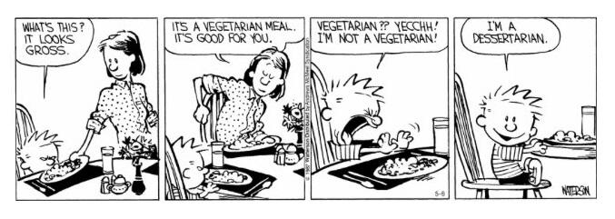
Nutrition
“Our food should be our medicine, & our medicine should be our food.”
(Hippocrates)

Slide 31
Nutrition
Unhealthy eating habits have contributes to the obesity epidemic in the US
About ⅓ of US adults are obese 33.8%
33.8% of the adult population
Defined as 20%+ over ideal weight
About 17% of children and adolescents are obese
By making smart food choices you can protect yourself from problems like
Heart disease
Diabetes
Osteoporosis
Some cancers

Slide 32
Nutrition
According to Dietary Guidelines for Americans 2015-2020, a healthy eating plan:
Emphasizes fruits, vegetables, whole grains, and fat-free or low-fat milk and milk products
Includes lean meats, poultry, fish, beans, eggs, and nuts
Is low in saturated fats, trans fats, cholesterol, salt (sodium), and added sugars
Stays within your daily calorie needs
How do we choose a healthy eating plan?
Focus on foods you enjoy, but healthier options
Fresh, Frozen or Canned Fruit (in water, not syrup)
Fresh, frozen, or canned vegetables - try something new grilled or steamed
Calcium-rich foods - a glass of low-fat or fat-free milk, low-fat or fat-free yogurt
A new twist on an old favorite - try baking or grilling instead of breading and frying

Slide 33
Debrief
It’s important to note, we spent a lot of time discussing exercise, but all 4 of the areas, physical fitness, rest, nutrition, and recreation, are all very important to the Pillar of the Body.
Let’s take a few minutes to discuss your thoughts on the different topics we’ve covered related to physical wellness
If there is a need for further resources, these may be able to be made available through your chain of command or the Health Service Corps

Slide 34
Ongoing Activities
The Civil Air Patrol is walking to Mars!
Read about it at https://www.cap.news/civil-air-patrol-launches-walk-to-mars/
Log your participation at: https://www.gocivilairpatrol.com/members/cap-walks-to-mars
We can’t get there without YOU!
Cadets can take part of the President’s Youth Fitness Program:
https://www.hhs.gov/fitness/programs-and-awards/presidential-youth-fitness-program/index.html
Senior Members as well as Cadets can use their smart devices to track exercise, diet, and collaborate on progress
CAP does not endorse any particular app, and use caution when downloading

Slide 35
Additional Resources
https://capchaplain.com/resources/wellness/
https://us.humankinetics.com/blogs/excerpt/definitions-of-leisure-play-and-recreation
https://www.gocivilairpatrol.com/programs/cadets/library#Fitness
https://www.sleepfoundation.org/articles/sleep-hygiene
https://hhs.gov/fitness/eat-healthy/dietary-guidelines-for-americans/index.html
https://recipes.heart.org

