Slide 1
Recruiting & Retention
24 April 2020
Presented as part of the Oregon Wing
Professional Development Workshop Series

Slide 2
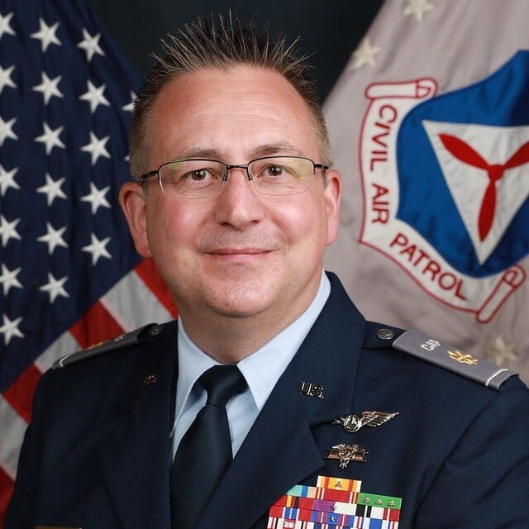
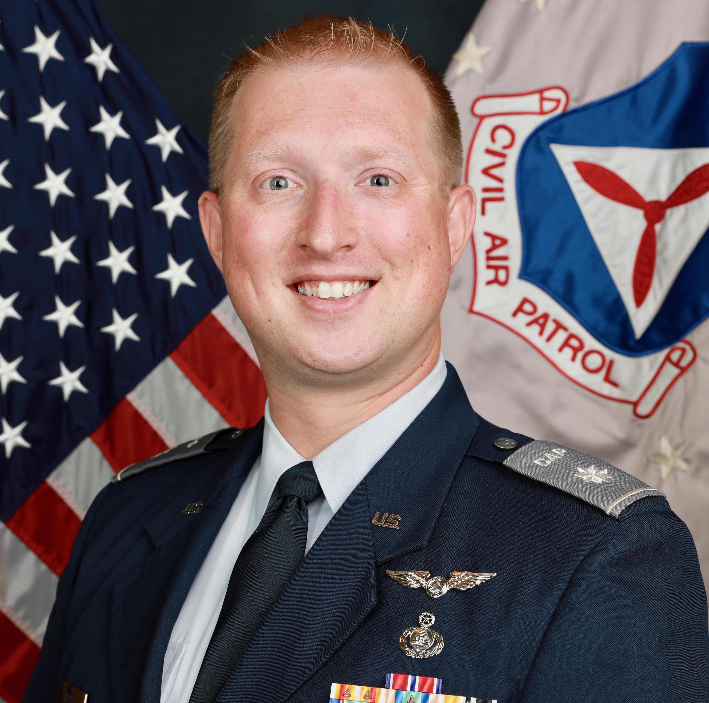
Welcome
Col Darin Ninness
Maj Michael Moore
Lt Col Edward Bos
NHWG/CC
CAP Recruiting Manager Emeritus
CAP Recruiting Manager
Former WAWG Recruiting Manager
ORWG/IG
Professional recruiting experience

Slide 3
Overview
Week 1
Week 2
Week 3
Beginning with 'Why?’
The Evolution of CAP Culture
Moving Onto How
CAP Job Description(s)
CAP Specialty Track Progression
Why Goal-Setting Matters
Annual Planning Activity for Recruiting
What Prospecting is, and How to Do it.
What is Cohort Recruiting
Steps & Best Practices
Tie-Ins with Other Directorates
Planning Activity
What is Year-Round Recruiting
Steps and Best Practices
Mentoring and Why it's Vital
Incentivizing Recruiting by Unit Members
Recruiting Skills
Sales Training Basics
Role Playing Exercise
Resources for Additional Training
Online
In-Person
Starting New Units
How it Benefits Existing Units
How it Benefits the Wing and the Corporation
Tactics, Techniques, and Procedures

Slide 4
Questions so Far?
Huh?

Slide 5
Beginning with ‘Why?’

Slide 6
Why Are You in CAP?
Let’s Discuss
Why are you in the Civil Air Patrol?
Why ARE you in the Civil Air Patrol?
Why are YOU in the Civil Air Patrol?
WHY are you in the Civil Air Patrol?

Slide 7
Why Are We Recruiting?
Let’s Discuss the Reasons for Appointing Recruiting & Retention Officers
For the community
For the unit
For the Civil Air Patrol
Do these reasons matter? Does CAP matter? Then recruiting is worth it!

Slide 8
The Evolution of CAP Culture

Slide 9
Perceptions
Attitudes
Values
Decisions
Expectations
Experiences
Behaviors
Stories
+ / -
Members join CAP based on their Perceptions of the unit, its membership, and its activities
Attitudes, Values, Decisions, Expectations, and Behaviors can be self-realized or peer-driven but leadership is able to exert little influence in these areas
Continuous Evolution
of Civil Air Patrol Culture
Experiences are the key point in the cycle where leadership can generate the greatest impact
Stories have both positive and negative influences on member perceptions and ultimately have the greatest impact on culture

Slide 10
Moving Onto ‘How’

Slide 11
What is Recruiting & Retention?
Let’s define it together so we have an agreed-upon starting point
This is a word-cloud based on CAPP 226
Notes:
Leave time for participants to answer. Record answers on whiteboard.

Slide 13
Job Description: Unit/Group
Formulates plans and establishes policies, procedures, and programs, designed to assist CAP in attracting new members and retaining current members at the unit level. They shall:
Plan, organize and conduct periodic membership drives and open houses to attract new members and to stimulate interest in current inactive members.
Provide content for unit web site pertaining to the membership process and other appropriate new member information.
Serve as the unit’s point of contact for recruiting matters and new member inquiries.
Make presentations to outside groups, both youth and adult, to attract new members.
Stage display booths and provide recruiting coverage at local high schools, shopping centers, air shows, and other public events.
Personally contact individuals expressing an interest in CAP by telephone, internet inquiry, etc, and follow up to ensure that all interested persons are fully informed on the CAP program and local unit activities.
Follow up with current members periodically during their membership year, and especially within 60 days of initial membership and between 120 and 90 days before membership renewal.
Informally survey members who chose to not renew to identify potential organizational or membership issues. Maintain a close watch on unit membership and participation trends to identify and engage members at risk of not renewing before they reach the end of their membership year.
Advise their respective commander on guidance from higher headquarters and statistics and trends related to recruiting and retention.
The Recruiting & Retention Officer should be familiar with all aspects of the Civil Air Patrol program, particularly the CAP Constitution and Bylaws, Civil Air Patrol History, CAPR 20-1, and CAPM 39-2.

Slide 14
Job Description: Wing/Region
Formulates plans and establishes policies, procedures, and programs, designed to assist CAP Commanders and Recruiting and Retention Officers at their echelon and subordinate echelons in attracting new members and retaining current members at the unit level. They shall:
Plan and conduct periodic awareness activities appropriate to their respective echelon to attract membership opportunities to subordinate echelons.
Make presentations to state & region-wide outside groups, both youth and adult, to attract new members and raise awareness of Civil Air Patrol, its membership, its missions and capabilities.
Ensure subordinate echelons have recruiting plans in place that are adequate and meet the goals and aims of their echelons. Assist subordinate echelon Recruiting & Retention Officers in creating recruiting & retention plans.
Provide content for wing/region web sites pertaining to joining Civil Air Patrol, means of contacting subordinate units, and any other applicable new member information.
Stage display booths and provide recruiting coverage at echelon-appropriate events, such as air shows, and other public events. Coordinate local efforts with wing or region assets (displays, aircraft, etc) to ensure maximum coverage.
Monitor the prospective member process to ensure that prospective members are responded to by subordinate units in a timely fashion.
Provide subordinate echelons with data and statistics pertaining to new member joins, retention rates and other key metrics.
Mentor group or squadron Recruiting & Retention Officers (wing) or wing Directors Recruiting and Retention (region) on matters of recruiting, techniques, training or other matters.
Conduct periodic training for Recruiting & Retention Officers at their echelon and below, to include Senior Professional Development Courses (SLS/CLC/TLC/RSC, etc) and wing and region conferences.
The Director of Recruiting & Retention should be familiar with all aspects of the Civil Air Patrol program, particularly the CAP Constitution and Bylaws, CAPR 20-1, and CAPM 39-2.

Slide 15
Questions so Far?

Slide 16
Specialty Track # 226
Technician
Senior
Master
2 years membership
6 mo’s in OJT
Attend 1 workshop (!)
Technician in another specialty
Planning session with CC
Prospect List
Present to non-CAP group
Visit another group’s meeting
Submit annual plan or report
Recruit 7-8 members
2 exit interviews
18 mo’s in OJT
2 more workshops
2 more planning sessions
2 more presentations
GES
ES participation
Hold recruiting event
2 more recruiting plans or reports
3 more exit interviews
12-24 mo’s in OJT
Attend a conference
2 more planning sessions
4 classifieds
2 more events
Host 2 workshops
2 more plans or reports
Update prospect list
Plan new unit

Slide 17
Specialty Track #226
Takeaways
Annual Planning & Reporting
Ongoing Recruiting Training (workshops, etc)
Ongoing Participation & Expertise in CAP (pro. dev., ES, etc)
Regular Outreach (speaking, visiting, etc)
Regular Recruiting Events (open houses, booths, etc)
Exit Interviews & Reporting (don’t withhold that information)
Recruiting New Members

Slide 18
Goal Setting
And Tying-in to annual planning

Slide 19
Why Goal Setting Matters
Give us a direction to work towards
Lets our leadership share a vision and know that we can see it too
Accountability
Manageability
Other thoughts?

Slide 20
Why Annual Planning Matters
In the job description
To identify goals for recruiting & retention
To identify resources for accomplishing goals
Accountability
Manageability
Continuity
You might get promoted to National Commander overnight

Slide 21
1st Exercise Begin
Annual Planning
20 Minutes
Worksheet Emailed

Slide 22
1st Exercise Debrief
Annual Planning
Thoughts?
How will you use this in the future?

Slide 23
2nd Exercise Begin
Prospecting
20 Minutes
Focus on Summary
Try 1 Prospect Detail Sheet

Slide 24
2nd Exercise Debrief
Prospecting
Thoughts?
How will you use this in the future?

Slide 25
In Summary
Why Recruiting?
Evolution of CAP Culture
Recruiting & Retention Responsibilities
Goal Setting
Annual Program Plan
Prospecting
Part 2 continues on 1 May 2020
2100 - 2230 hrs EDT
1800 - 1930 hrs PDT
0100 - 0230 hrs UTC (2 May 2020)
Until then, if you have further questions:
mmoore@cap.gov
dninness@cap.gov
edward.bos@orwgcap.org

