Slide 1
Emergency Services
5 June 2020
Presented as part of the Oregon Wing
Professional Development Workshop Series

Slide 2
Welcome
Maj Frank deBros
Maj Michael Zabetakis
Lt Col Edward Bos
CAP ES Curriculum Developer
Master Rated ESO
NESA GSAR Deputy
Master Rated ESO
ORWG/IG
Master Rated ESO

Slide 3
Overview
Week 1
Week 2
Week 3
Specialty Track Overview
Position Overview
Annual Planning
Integration Across Echelons
Relationship Management
Tools & Resources
Online Systems
Emergency Services Training Overview
Event Training Plans
Process Improvement
Emergency Services Awards
Roundtable Discussion

Slide 4
Questions so Far?
Huh?

Slide 5
Specialty Track Overview

Slide 6
Specialty Track # 213 (From CAPP 70-3)
Technician
Senior
Master
FEMA IS Training
ICS 100, 200, 700, & 800
Reading List (per OJT Mentor)
ADCON, OPCON, TACCON
Training Resources List
Notification Procedures
Using eServices
Using WMIRS
Admin Retention
Annual Training Plan
Mission Qualification & Participation
6-Month Internship & Online Exam
Mission Qualification & Participation
IMT Qualification
Conference Seminar Participant
WMIRS Proficiency
Discuss the NOC
FRO Training (not appointment)
ES & Staff Interaction
Local Documentation Procedures
Broadening Course
Oversee 12 Months Ongoing Training (e.g., for a unit)
Update Training Plan
Level II
Customer Relations Visit
12-Month Internship & Online Exam
Mission Qualification & Participation
IMT Supervisor Qualification
Conference Seminar Host
Process Awards
Process Safety Scenario
Mentor ES Qual Trainee (documentation)
Update Training Plan
Broadening Course
Outside-Agency Training for CAP
Mentor Junior ES Officer
Advice Liaison on CAP
Level III
18-Month Internship & Online Exam

Slide 7
Notes on Cadets
NOTE: CADETS CANNOT BE APPOINTED AS THE PRIMARY UNIT ES OFFICER
Per CAPR 35-6, paragraph 3-a. (dated 23 JAN 15)
CAP Basic Emergency Services Qualification Badge: Complete all requirements of CAPP 213, Emergency Services Officer-Specialty Track Study Guide, Technician Rating. Cadets can earn the Basic Emergency Services Qualification Badge as they can complete all of the requirements for this rating, though they cannot officially receive the Technician Rating until they become a senior member
Document completion of requirements
CAPP 70-3 to track
CAPF 2A (‘Other’ in Box III)
Approved by Wing/CC or Designee
Update E-Services
OpsQuals > CAPR 35-6 Ratings, Awards, & Badges > Member > CAP Basic ES Qualification Badge
Can continue to be worn as a Senior member, even if not in ES
CAPR 35-6, para 8-e.
NOTE: THIS PROCESS WILL LIKELY CHANGE WHEN THE NEW PROFESSIONAL DEVELOPMENT SYSTEM IS RELEASED

Slide 8
Position Overview

Slide 9
Breakout #1: 5 Minute Discussion
As a group, discuss the most common functions of ES Officers
Also, please identify one or two important functions that do not get accomplished regularly
Notes:
Leave time for participants to answer. Record answers on whiteboard.

Slide 11
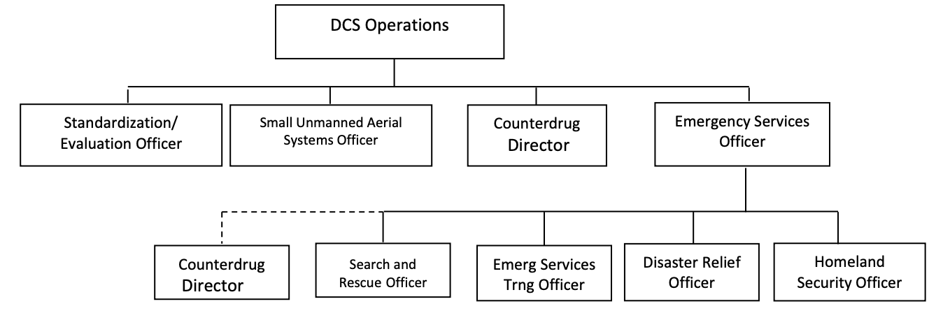
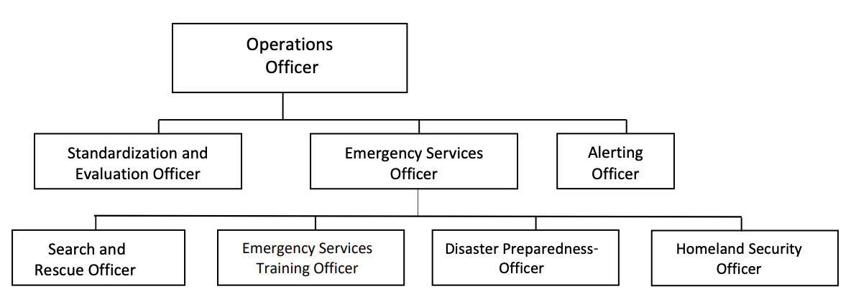
Organizational Charts
Region
Wing
Squadron

Slide 12
Job Description: ES Officer
Manages and directs emergency services activities. They shall:
Develop agreements with agencies responsible for search, domestic emergencies, and civil defense.
Develop and maintain an adequate emergency service force.
Develop training programs to ensure that highly qualified ES personnel are available for search and rescue, and disaster relief missions.
Develop plans and standard operating procedures to support the wing’s emergency services program.
Maintain records to determine the status of resources (personnel, vehicles aircraft, radios and other emergency equipment) available for ES missions.
Develop and maintain a rapid alerting system for assembling necessary resources in a timely manner.

Slide 13
Job Description: ES Training Officer
Assists the ES Officer in managing and directing ES training activities. They shall:
Document ES training accomplished and qualifications earned.
Coordinate with the SAR and DR officers to ensure that training programs are adequate.
Coordinate with external agencies for other ES training.
Prepare and process CAPFs 101 for new or requalifying personnel.
The ES training officer should be familiar with CAPP [70-3], and applicable FEMA publications.

Slide 14
Job Description: Homeland Security Officer
Manages HLS and monitors and supports emergency services activities. This includes:
Works closely with the other operations staff officers to prevent duplication of effort and to ensure CAP presents one clear voice to potential Homeland Security customers.
Develop agreements and maintain contact with state and local emergency management officials pertaining to HLS. Ensures coordination with unit Emergency Services Officer regarding requirements.
Works closely with Emergency Services Officer to ensure unit resources are capable of responding to appropriate requests in support of homeland security.
Monitors CAP training to ensure the HLS program is adequate to include, proper equipment (cameras, computers and radios, etc.) and training to accomplish complete aerial and ground photo reconnaissance mission requests.
Monitors unit procedures for rapid alerting and assembling of unit personnel to support homeland security tasking requirements.
Monitors unit homeland security evaluations, training missions and exercises.
Know CAP’s homeland security responsibilities in all operational areas.
The homeland security officer should be familiar with CAP directives in the 60, 62, 66, 77 and 100 series; and applicable federal, state and local MOUs.

Slide 15
Job Description: Search and Rescue Officer
Assists the ES officer in managing and directing search and rescue activities. They shall:
Develop SAR agreements with state emergency management officials and other CAP units, if needed.
Know CAP SAR responsibilities in areas of operation.
Develop a unit SAR force that is capable of responding to request from the appropriate Rescue Coordination Centers or other responsible agencies.
Ensure the SAR training program is adequate.
Develop operational procedures for rapid alerting and assembling of SAR task force personnel.
Coordinate wing SAR evaluations, training missions, and exercises.
The search and rescue officer should be familiar with CAP directives in the [70] 62, 66, 77 and 100 series; CAPP [70-3] and CAPP 2; applicable FEMA publications; and SAR related federal, state and local MOUs.

Slide 16
Job Description: Disaster Relief Officer
Assists the ES Officer in managing and directing disaster preparedness activities. They shall:
Develop agreements with state emergency management officials pertaining to natural disaster and civil defense activities.
Develop a unit disaster preparedness force capable of responding to appropriate requests.
Ensure the civil defense and natural disaster training programs are adequate.
Develop operational procedures for rapid alerting and assembling of disaster preparedness task force personnel.
Coordinate wing DR evaluations, training missions, and exercises.
Know disaster preparedness responsibility of CAP in areas of operation.
The disaster preparedness officer should be familiar with CAP directives in the [70], 62, 66, 77 and 100 series; CAPP [70-3]; DR related federal, state and local MOUs, and applicable FEMA publications.

Slide 17
Job Description: Counter Drug Officer
Applicable to Wing/Region only
Manages and directs counterdrug activities. They shall:
Process applications for personnel entering the CD program.
Maintain an adequate number of trained CD personnel.
Schedule orientation programs to ensure highly qualified CD personnel are available to support law enforcement agencies.
Develop plans and standard operating procedures to support the region/wing’s CD program.
Serve as the advisor to the commander and Operations staff for CD activities.
Report results of CD efforts to appropriate authorities.
The counterdrug officer should be familiar with CAP directives in the [70], 62, 66, and 100 series; applicable FEMA publications; and CD related federal, state and local MOUs.

Slide 18
Takeaways: ES Officers Do
ES Officers Advise and Commanders Decide (so have good advice!)
Program Admin & Management
Document Retention
Annual Priorities & Planning
Processing Awards,
Etc
Relationship Management
Potential Customers
Potential Partners
Internal Customers
Leadership
Trainees
Qualified Mission Personnel
Ongoing Training and Cultivation of Expertise

Slide 19
Takeaways: ES Officers Don’t
ES Officers Don’t Manage Missions
ADCON, not OPCON/TACCON
This is done by Incident Commanders
ES Officers Don’t Sign Contracts/MOUs
Established process through General Counsel’s office
Generally unnecessary to create local MOU
ES Officers Don’t Enact Policy
Commanders enact policy
ES Officers should advise & inform

Slide 21
Annual Planning

Slide 22
Why Annual Planning Matters
In the job description
To identify goals for recruiting & retention
To identify resources for accomplishing goals
Accountability
Manageability
Continuity
You might get promoted to National Commander overnight

Slide 23
Why Goal Setting Matters
Give us a direction to work towards
Lets our leadership share a vision and know that we can see it too
Accountability
Manageability
Other thoughts?

Slide 24
Annual Planning Steps
Review Previous Plans
What was accomplished
What wasn’t, & why
Communicate with Leadership
Revise priorities and objectives
Identify resources & tools
Assemble Plan
Sufficient detail to accomplish goals
Coordinate Across Echelons
More on this shortly
Things to Include
Training & evaluation to maintain sufficient personnel
Exercises, including those outside of unit
Relationship building with other organizations & the community
WHO, will do WHAT, by WHEN, and HOW

Slide 25
INTEGRATION ACROSS ECHELONS

Slide 26
Integration Across Echelons
Strategic Plan Sets Trajectory & Intent (Unity of Command)
Commanders Set Staff-Informed Objectives
Goals Support Objectives
Plans Pursue Goals
Plans Roll-Up & Integrate
Staff Coordinate with Counterparts to Build Efficiency (Unity of Effort)
Training
Exercises
Alerting & Responding
Relationship Management Synergy
Units make local contacts
Units share with counterparts
Groups/Wings make area/statewide contacts
Coordination makes this easier

Slide 27
Region/CC
Region/DO/DOS
XXWG/CC
YYWG/CC
ZZWG/CC
XXWG/DO/DOS
YYWG/DO/DOS
ZZWG/DO/DOS
XX-002/CC
XX-003/CC
YY-012/CC
YY-013/CC
ZZ-022/CC
ZZ-023/CC
XX-002/ DO/DOS
XX-003/ DO/DOS
YY-013/ DO/DOS
YY-013/ DO/DOS
ZZ-022/
DO/DOS
ZZ-023/
DO/DOS

Slide 28
Region/CC
Region/DO/DOS
XXWG/CC
YYWG/CC
ZZWG/CC
XXWG/DO/DOS
YYWG/DO/DOS
ZZWG/DO/DOS
XX-002/CC
XX-003/CC
YY-012/CC
YY-013/CC
ZZ-022/CC
ZZ-023/CC
XX-002/ DO/DOS
XX-003/ DO/DOS
YY-013/ DO/DOS
YY-013/ DO/DOS
ZZ-022/
DO/DOS
ZZ-023/
DO/DOS

Slide 29
In Summary
Specialty Track Overview
Position Overview
Annual Planning
Integration Across Echelons
Part 2 continues on 12 June 2020
2100 - 2230 hrs EDT
1800 - 1930 hrs PDT
0100 - 0230 hrs UTC (13 June 2020)
Until then, if you have further questions:
mzabetakis@nesa.cap.gov
frank.debros@gmail.com
edward.bos@orwgcap.org
Everyone is welcome to stay on the Zoom call to chat for a few minutes.

