Slide 1
Recruiting & Retention
1 may 2020 (Part 2 of 3)
Presented as part of the Oregon Wing
Professional Development Workshop Series

Slide 2
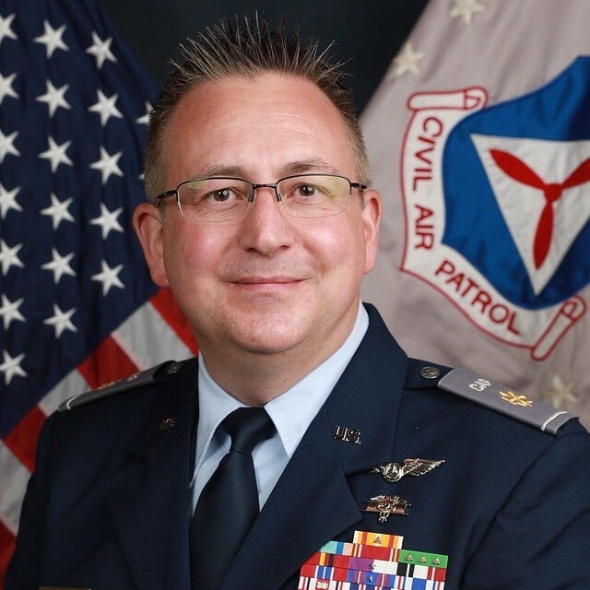
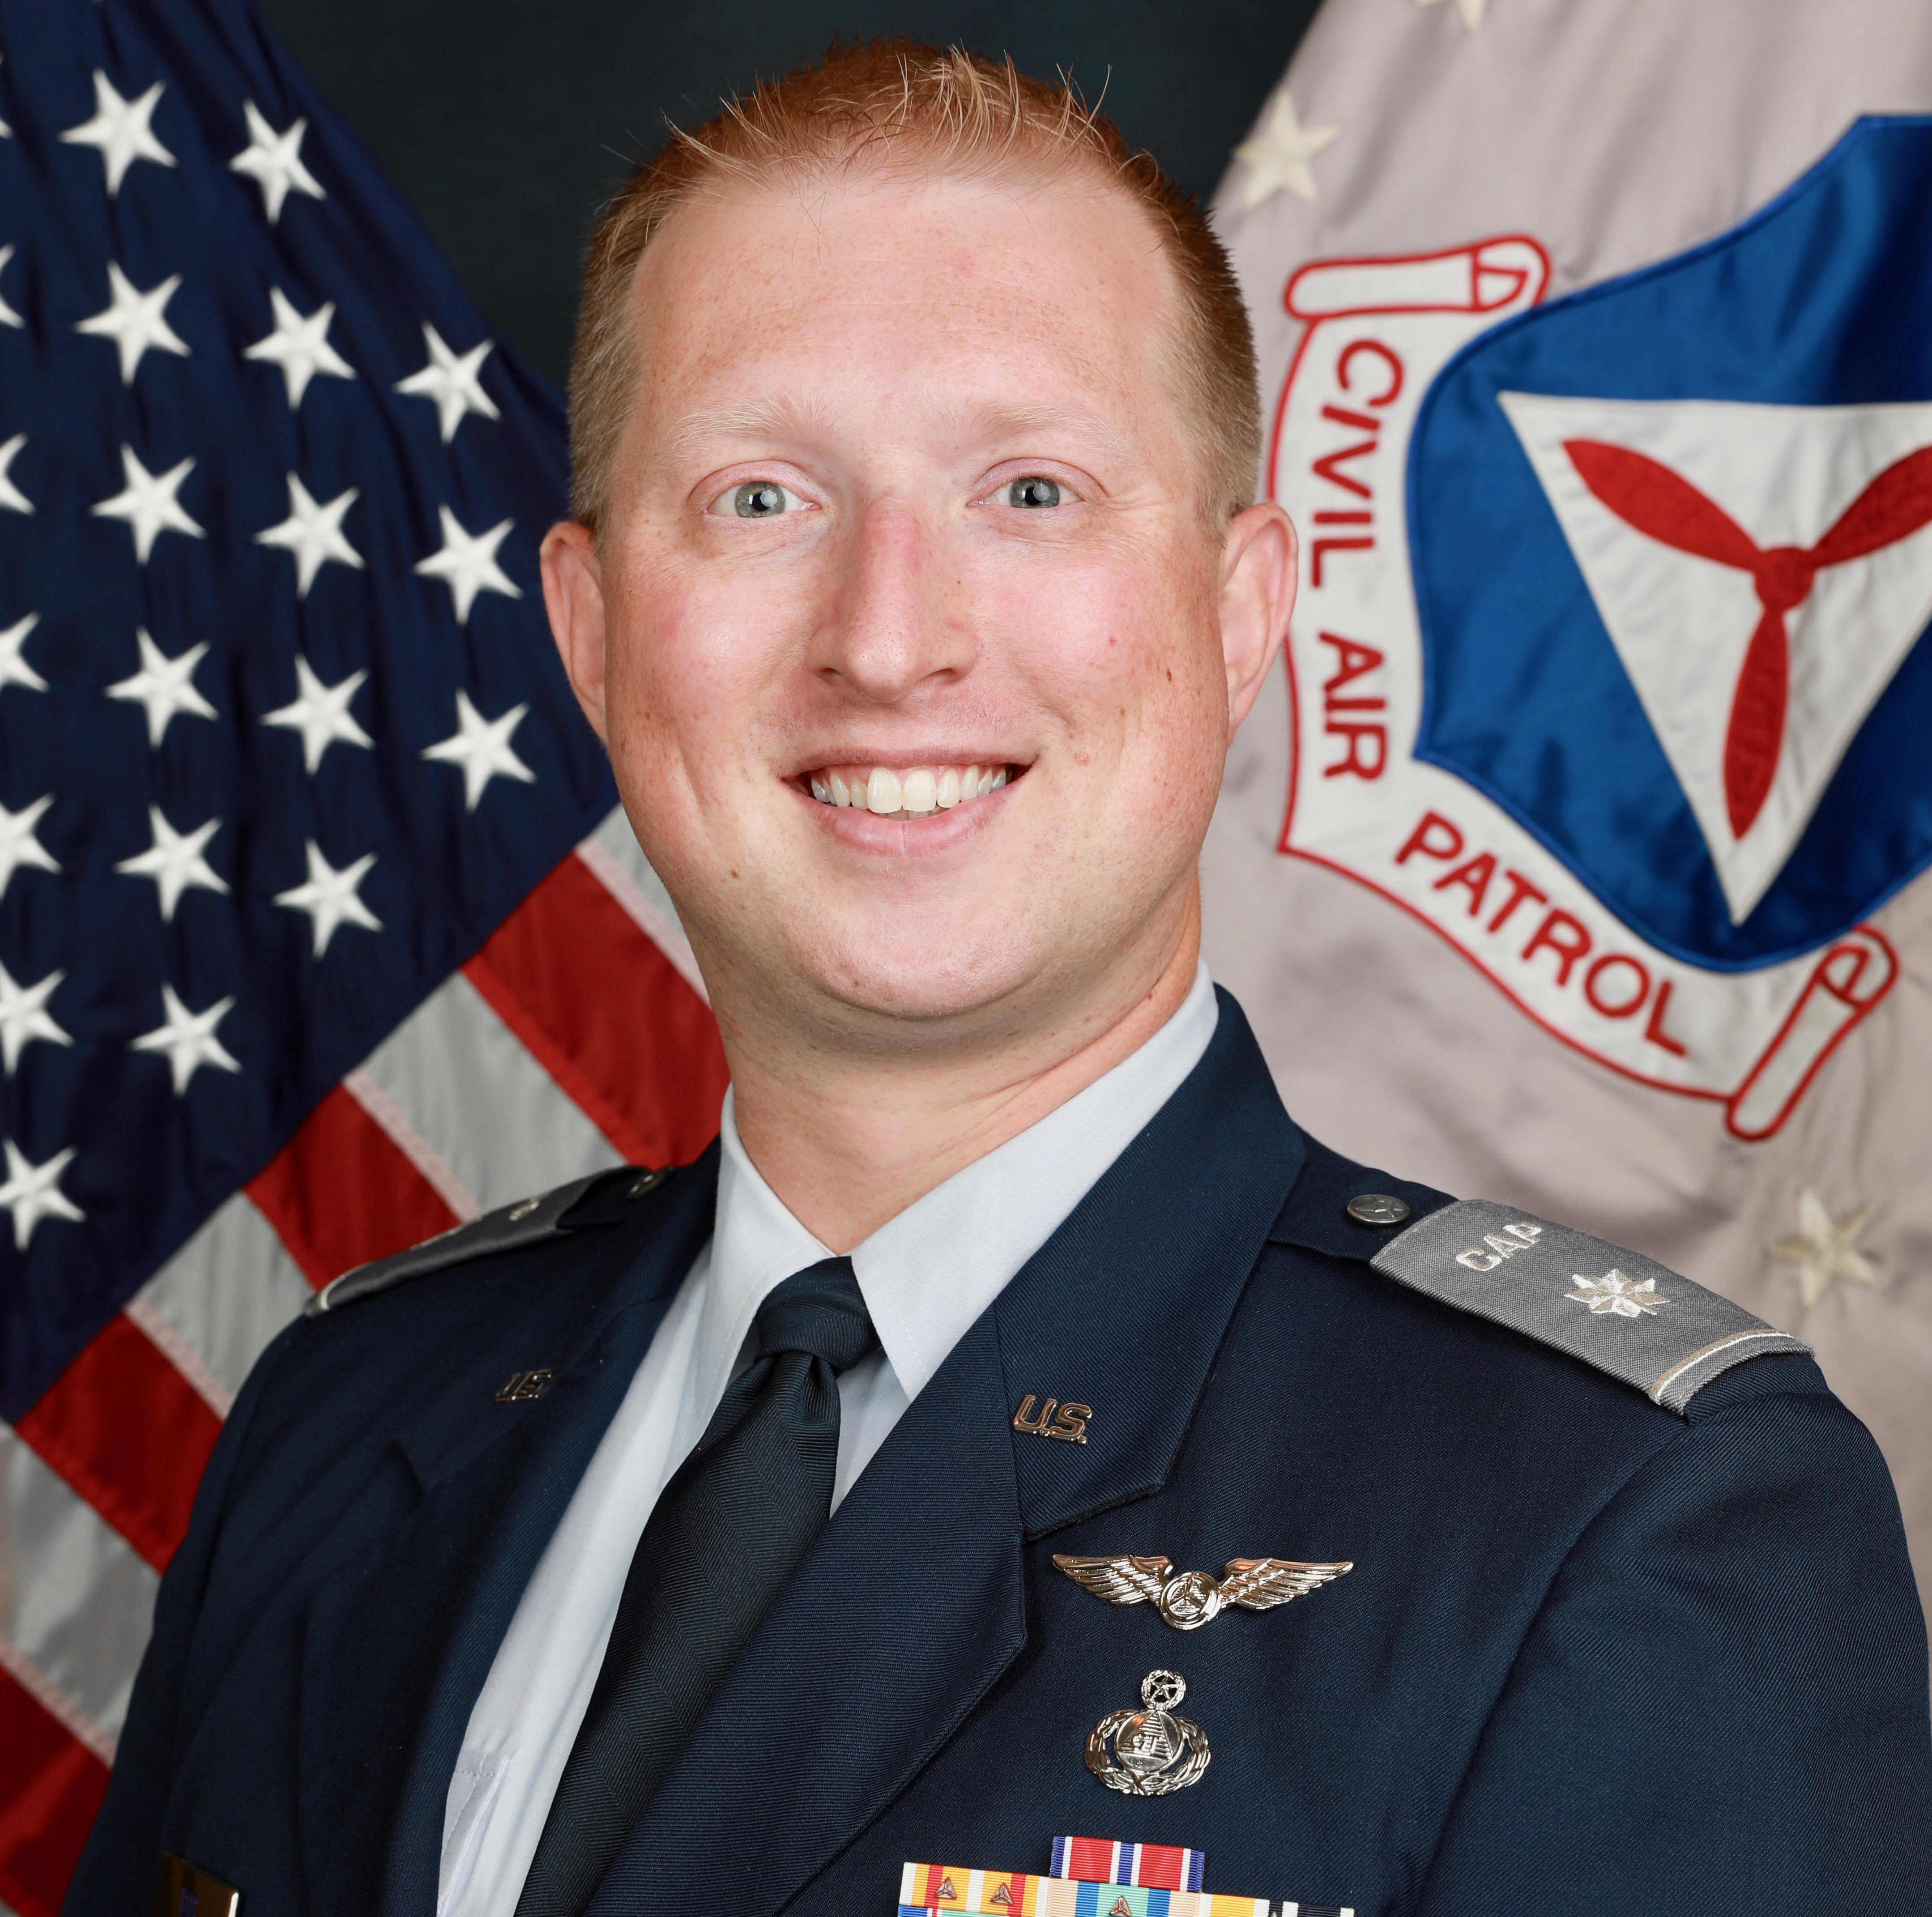
Welcome
Col Darin Ninness
Maj Michael Moore
Lt Col Edward Bos
NHWG/CC
CAP Recruiting Manager Emeritus
CAP Recruiting Manager
Former WAWG Recruiting Manager
ORWG/IG
Professional recruiting experience

Slide 3
Overview
Week 1
Week 2
Week 3
Beginning with 'Why?’
The Evolution of CAP Culture
Moving Onto How
CAP Job Description(s)
CAP Specialty Track Progression
Why Goal-Setting Matters
Annual Planning Activity for Recruiting
What Prospecting is, and How to Do it.
What is Cohort Recruiting
Steps & Best Practices
Tie-Ins with Other Directorates
Planning Activity
What is Year-Round Recruiting
Steps and Best Practices
Mentoring and Why it's Vital
Incentivizing Recruiting by Unit Members
Recruiting Skills
Sales Training Basics
Role Playing Exercise
Resources for Additional Training
Online
In-Person
Starting New Units
How it Benefits Existing Units
How it Benefits the Wing and the Corporation
Tactics, Techniques, and Procedures

Slide 4
Questions so Far?

Slide 5
Cohort Recruiting

Slide 6
What is Cohort Recruiting?
Cohort recruiting is the process of channelizing the new member recruiting, inprocessing or on-boarding and training functions into well defined chunks or “cohorts” of members
In the Cadet Great Start materials, this is referred to as “pipeline” recruiting

Slide 7
Why Use Cohort Recruiting?
Units already have limited resources, use wisely!
Cohort takes advantage of economies of scale
Concentrates new member admin requirements in a smaller period
Concentrates training events and introduction to CAP

Slide 8
Why Use Cohort Recruiting?
Build repeatability and consistency of action
Maximizes training value for both new members & trainers
Reduces administrative overhead
Creates a “New Member Experience”

Slide 9
Impact on Cadet Unit Award

Slide 10
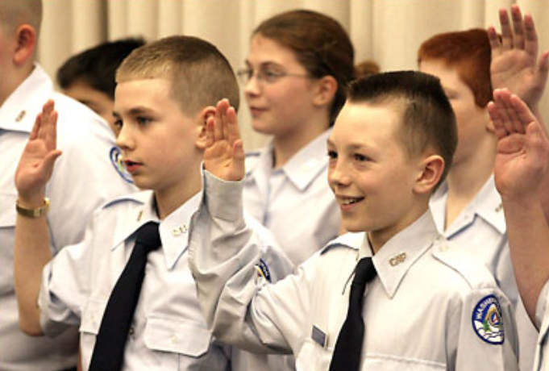
Other Impacts
You might recognize this photo from the Great Start Guide.
It was taken by a local newspaper during the graduation of our first cohort class after Maj Moore took command of McChord Squadron back in 2003.
All three of the cadets in that photo have gone on to become "dynamic citizens".

Slide 11
Cohort Recruiting Disadvantages
Does not satisfy the “right now” crowd.
(This might actually be a “pro”)
Very different from the norm. Takes some convincing people to buy in.
“But we’ve never done it this way before!”
Potential to lose prospective members due to waiting for your next cohort training.
Many youth organizations have open enrollment periods, this isn’t unusual

Slide 12
Cohort Recruiting Advantages
Repeatable – After 1-2 times, you can do it in your sleep.
Builds economies of scale
Makes your unit look professional
Improves resource use: trainers, administrative overhead
Treat new members like new members: train them correctly

Slide 13
Cohort Effort – Look at the Timelines
With Trickle-In Recruiting
= 10 cadets
JAN
FEB
MAR
1
1
2
2
1
3
Great Start (5 wks)
Great Start (5 wks)
OR
Unit BCT Program (8-10 wks)
With Cohort Recruiting
JAN
FEB
MAR
= 10 cadets
10
Great Start (5 wks)
OR
Unit BCT Program (8-10 wks)
Notes:
With trickle-in recruiting, how effective is your training if you have people at varying levels (days) of training within the group? People enter and exit randomly or at a whim? You have to repeat the same basic subjects over & over or bring others up to speed?
What happens is, those who are already training are annoyed, those joining up later are playing catch up, and your trainers are not effectively utilized
Never mind always conducting membership boards, verifying documents

Slide 14
Cohort Does Require:
A plan
A plan to execute a training cohort from start to finish
A plan for after the initial training
A unit schedule (you do have a schedule, right?)
Continuous advancement
People want to be involved things that are organized and “together.”
Cohort requires planning
Cohort requires organization
Notes:
This is all about planning.
You have to have a plan to train them, and you need an active, vibrant squadron for them to “graduate into”

Slide 15
Building Your Cohort Plan
You should have the date 6-10 weeks in advance (for example, know at least “in September” by May or June)
All planning backs up from your unit’s recruiting event
4+ weeks out, have flyers, advertising
Make sure everybody in the unit knows the timeline! (When recruiting, members will get asked. If the member doesn’t know, it will look unplanned and sloppy)

Slide 16
Build Your Advertising
Flyers – Seem to work great. Definitely a 1m item
Newspaper – Who reads that anymore?
Patch.com – It’s the “new” newspaper.
Facebook – Yes, please! Pay for $25 in targeted ads to start. Work your way up
Web – You have to have one these day
RSVP – Use Eventbrite or a Google Form for RSVPs
Notes:
Flyers get the “FIVE W’s” Who, What, When, Where and WHY home to stick on the fridge, hang in a window, etc
Not sure anybody reads the paper anymore, but doesn’t hurt to put ads in
If you have an “area Patch.com” for your town, get signed up to post items
Facebook advertisting works well, start small, target age groups, locations and interests. Its well worth it!
Do you have a website? Is it up to date? Can some one EASILY get in touch with your unit thru the website?

Slide 17
Ease Contact
Have multiple contact avenues.
Use multiple people, not just one. Just one is a single point of failure.
Follow up with all interested parties.
Have a canned email you can cut/paste easily, saves time.
Do it within a few days of initial contact.
Notes:
Contact avenues
Contact form on website
Email links
Facebook messages/page
Phone number (one that someone answers!)

Slide 18
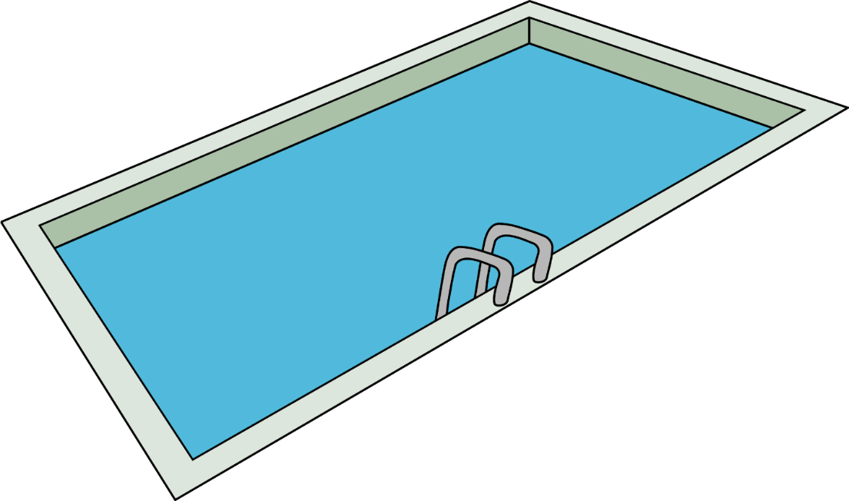
Filling the Tank
You’re always “filling the tank”, building your prospects pool
Use a spreadsheet, text file, database? You decide. Its your pool!
Name, address, phone, email, status, contact dates, etc.
Automate it if you can using Mail Chimp, Google Forms, etc
Have more than 1 member doing this.
Get back to inquiries IMMEDIATELY. Don’t wait!
Notes:
You should have an active pool of “interested prospects”

Slide 19
Filling the Tank
WEB
EMAIL
VISITS
PHONE CALLS
YOUR PROSPECTS POOL

Slide 20
Need a Different Pool?
EMAIL
VISITS
LEGAL OFFICER
PROSPECTS
POOL
EMAIL
WEB
VISITS
PHONE CALLS
WEB
PHONE CALLS
CHAPLAIN
PROSPECTS
POOL
PHONE CALLS
NCO CORPS
PROSPECTS
POOL
WEB
VISITS
EMAIL

Slide 21
Filling the Tank
Contacts & follow-ups are key.
They need the personal touch.
Be able to tell them when to come to your unit.
Stay up with the prospects in your pool. Send follow ups and notifications
Notes:
(the #1 complaint from prospective members – “I can’t get in touch with anybody locally”)
Notifications 4-6 weeks out and 2-3 weeks out

Slide 22
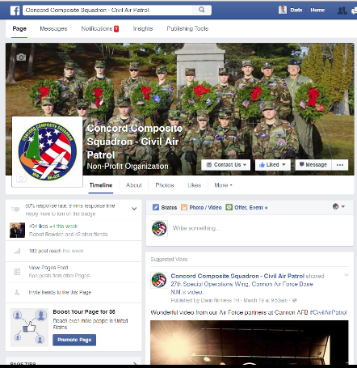
Preparing For The Event
FACEBOOK + OTHER SOCIAL MEDIA
YOUR PROSPECTS POOL
COMMUNICATION
YOUR UPCOMING RECRUITING NIGHT EVENT!!
TV
FLYERS
NEWSPAPER
Notes:
Not to mention word of mouth, etc

Slide 23
Hold Your Recruiting Event (Kickoff)
Purpose: To get people inside your 1m recruiting zone.
Open House, Recruiting Night, STEM Fair.
Whatever you want to call it: HAVE ONE

Slide 24
Hold Your Recruiting Event (Kickoff)
KISS principle
Brief on the organization. Show people what we do
Talk about “How to Join.” Explain the process. Tell them how to show up next week.
“Call to join” by your C/CC
Hands-on activities (2-3), led by Cadets. Get prospects engaged!
Takeaways: Put something in their hand to look over at home. Like a member packet!
Food. Seriously, food.
Let your members recruit: Cadets recruit cadets, adults recruit adults.
Sell the CAP you have, not some other CAP

Slide 25
Notes:
Unit even on 3 March

Slide 26
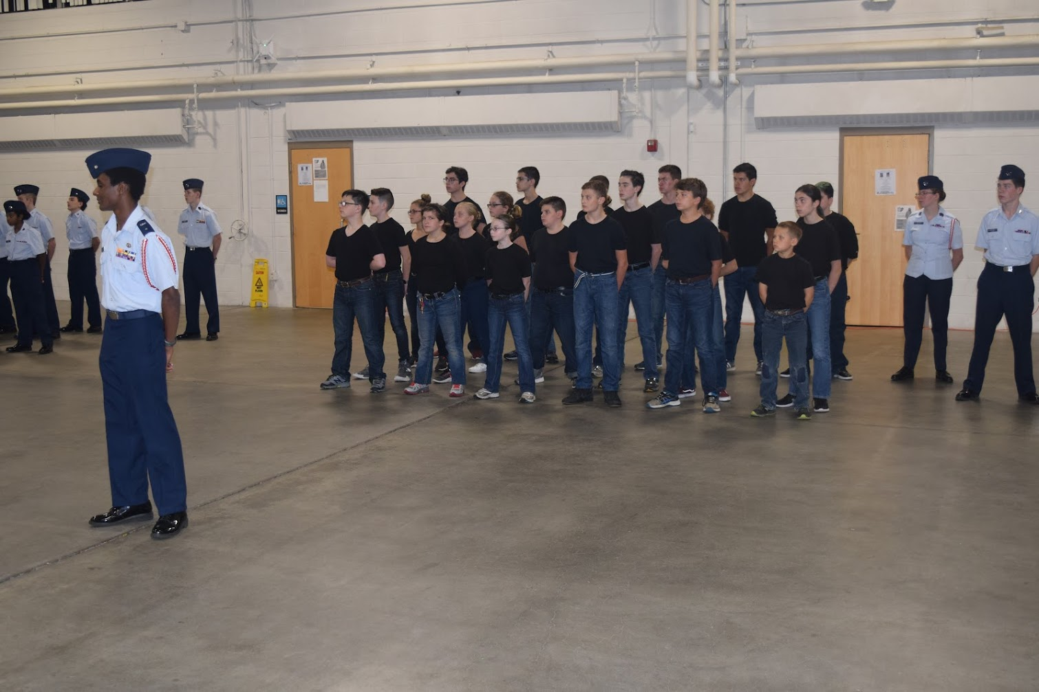
Notes:
Start with a motley collection

Slide 27
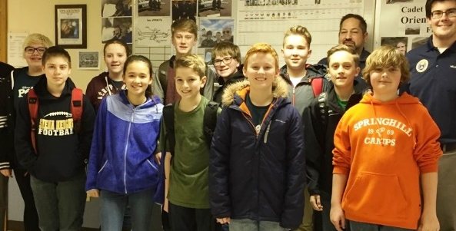
Now You Have Them!
YOUR PROSPECTS POOL
YOUR EVENT!!
TRAIN ‘EM!
GREAT START OR BCT PROGRAM
GO!!
Notes:
You got them, you’ve shown them the program’s worth. NOW TRAIN THEM!

Slide 28
Now, Train the Cohort
Have a definitive start & end of training (whether you use Great Start or your own Basic Cadet Training)
Have a plan, put them into the mix immediately (the following week)
Put them together, and train them together

Slide 29
Integrate The Cohort To the Unit
Complete your training on time
Invite moms and dads, make a big deal out of the graduation
Promote cadets who have completed their Curry (perhaps not all will)
Assign cadets to your flights, hand them over to your cadet NCOs for follow on training

Slide 30
Now You Have Them!
YOUR PROSPECTS POOL
YOUR EVENT!!
END
GREAT START OR BCT PROGRAM
START
GRAD
A FLIGHT
B FLIGHT
C FLIGHT
YOUR AWESOME SQUADRON
Notes:
Integrate the cohort into your unit. Put them in you flights

Slide 31
Tie-Ins with Other Directorates
Command Team
Guidance
Approval
Personnel
Identify Needs
Membership Review Boards
Process New Membership
Create Personnel Files
Professional Development
Planning ‘Cohort’ Training for Adults
Finance
Printing
Events
Incentives
Cadet Programs
ID New Sources
Planning Cohort Training
Support for Events
Recruiting Force Multiplier
Planning Follow-On Training for Rest of Unit
Aerospace Education
Support for Events
Recruiting Force Multiplier
Emergency Services
Support for Events
Recruiting Force Multiplier
Public Affairs
Marketing
Diversity
ID New Sources

Slide 32
Common Mistakes
No well communicated and planned out event
No advertising/publicizing online.
No fliers.
Notes:
Units don’t advertise and expect people to just show up and find them? How did you expect to get them in the door if you don’t advertise?
They work, and they’re cheap.
2 weeks out the unit members don’t know they are having an event, or they change it at the last second. How do prospective members find out if your own members don’t know?

Slide 33
Common Mistakes
Uninteresting event. Too long event. Zzzzzzzz
No food. Feed people!
No plan for what happens AFTER training.
No follow up with prospects or contacts beforehand.
No follow on training / progression
Selling the wrong things
Not repeatable
Notes:
What part of “meh” makes people join?

Slide 34
Maintain Your Cohort
Follow up at intervals after joining
With the cohort, its easier for fellow members to notice when someone is missing
It becomes self-encouraging
Watch for those who lag behind their cohort peers – it will be obvious.
10 C/TSgts and 1 C/SrA. That guy needs help.

Slide 35
Maintain Your Cohort
Follow up with members not showing up (this applies w/o cohort, BTW)
Get them before they lose interest
Cadets, especially those doing sports, school plays, etc, are easily “out of the loop,” so work to re-engage these members.
Communicate to your membership regularly

Slide 36
Get it?!
Time for a break.

Slide 37
Year-Round Recruiting

Slide 38
Why Use It?
Not used the same way as cohort recruiting:
General Senior Member Recruiting
Recruiting for specific skills (e.g., Chaplain or Pilot)
Sometimes Cohort Recruiting Doesn’t Fit
But to be fair, it really should

Slide 39
Steps
Consistent Advertising
Unit Website (!!!!!)
Unit Social Media
Facebook, Instagram, LinkedIn, Twitter, NextDoor
Avoid potential pitfalls (e.g., TikTok, SnapChat, etc)
Traditional media outlets (print, radio, TV)
Professional organizations (bar association newsletter for recruiting legal officers)
Public Presentations & Events (Rotary Club, or local airshow)

Slide 40
Advertise!
FACEBOOK + OTHER SOCIAL MEDIA
YOUR PROSPECTS POOL
COMMUNICATION
YOUR ONGOING AWESOME MEETINGS & EVENTS
TV
FLYERS
NEWSPAPER
Notes:
Not to mention word of mouth, etc

Slide 41
Mentoring & Why It’s Vital
Your prospect walks in the door, for a regular senior member, that’s 75% of the sale
We don’t need to pressure them
We need to answer their questions and provide guidance
Step 1 – Friendly welcome and greeting
Step 2 – Get introduced to the commander (if able)
Step 3 – Get assigned a mentor, a wingman, a battle-buddy, a conjoined Airman who will answer questions and show the ropes
Step 4 – Invite them to Join

Slide 42
Mentoring & Why It’s Vital
A prospective member will have questions
Choose mentors who
Can answer questions
Can be friendly and professional
Won’t go out of their way to alienate the potential new member
Won’t walk away and leave the new member alone without handing off
Prospective members (and newly-joined members!) frequently get left to fend for themselves and don’t come back

Slide 43
Incentivizing Recruiting

Slide 44
What is a Spiff?
It’s an immediate award for making a sale, an incentive program.
How does this apply to us?
What we have Organization-Wide:
Ribbons
Specialty Track Progression
Recognition & Advancement
Notes:
Leave time for participants to answer. Record answers on whiteboard.

Slide 45
Unit Incentives
What we can do locally:
National Incentives
Ribbons, Recognition, Advancement
Local Prize Box
The patches, t-shirts, commemorative mugs, & “stuff” otherwise taking up space in the unit filing cabinets
Big Incentives
E.g., If you recruiting 12 new Cadets, you get Encampment Fees Waived
Keep it legal, in good taste, and approved by the Finance Committee

Slide 46
Your Incentive Plan
Track Recruiting Reports
Submit Form 2A for Recruiter Ribbons
Prompt Unit Commander to Award Ribbons Publicly
Remind Members to Recruit
Develop Local Incentives
From incentives as big as you can manage, to incentives as small as are effective

Slide 47
Incentive Pitfalls
Don’t just chase numbers, they’re important but not everything
A unit with “100 members” but only 3 active folks can’t do the mission
And next year your recruiting goal becomes 150, but you only have 5 renewals…
Don’t forget the important of Membership Boards
Square pegs don’t fit in propeller-shaped holes
Don’t forget to have an amazing and engaging program
Cadets
Seniors

Slide 48
Questions so Far?

Slide 49
Exercise Begin
Join Night Information Packets
10 Minutes
In Small Groups Answer:
What goes into Cadet Packets?
What does into Senior Member Packets?
Do pilots or chaplains get different information?

Slide 50
Exercise Debrief
Join Night Information packets
Anyone want to report?
Col Ninness Sample

Slide 51
In Summary
Cohort Recruiting
Year-Round Recruiting
Incentivizing Recruiting
Join Night Packets Exercise
Part 3 continues on 8 May 2020
2100 - 2230 hrs EDT
1800 - 1930 hrs PDT
0100 - 0230 hrs UTC (2 May 2020)
Until then, if you have further questions:
mmoore@cap.gov
dninness@cap.gov
edward.bos@orwgcap.org

