Slide 1
Recruiting & Retention
8 may 2020 (Part 3 of 3)
Presented as part of the Oregon Wing
Professional Development Workshop Series

Slide 2
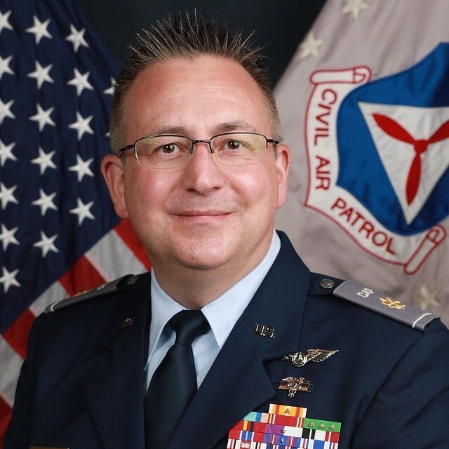
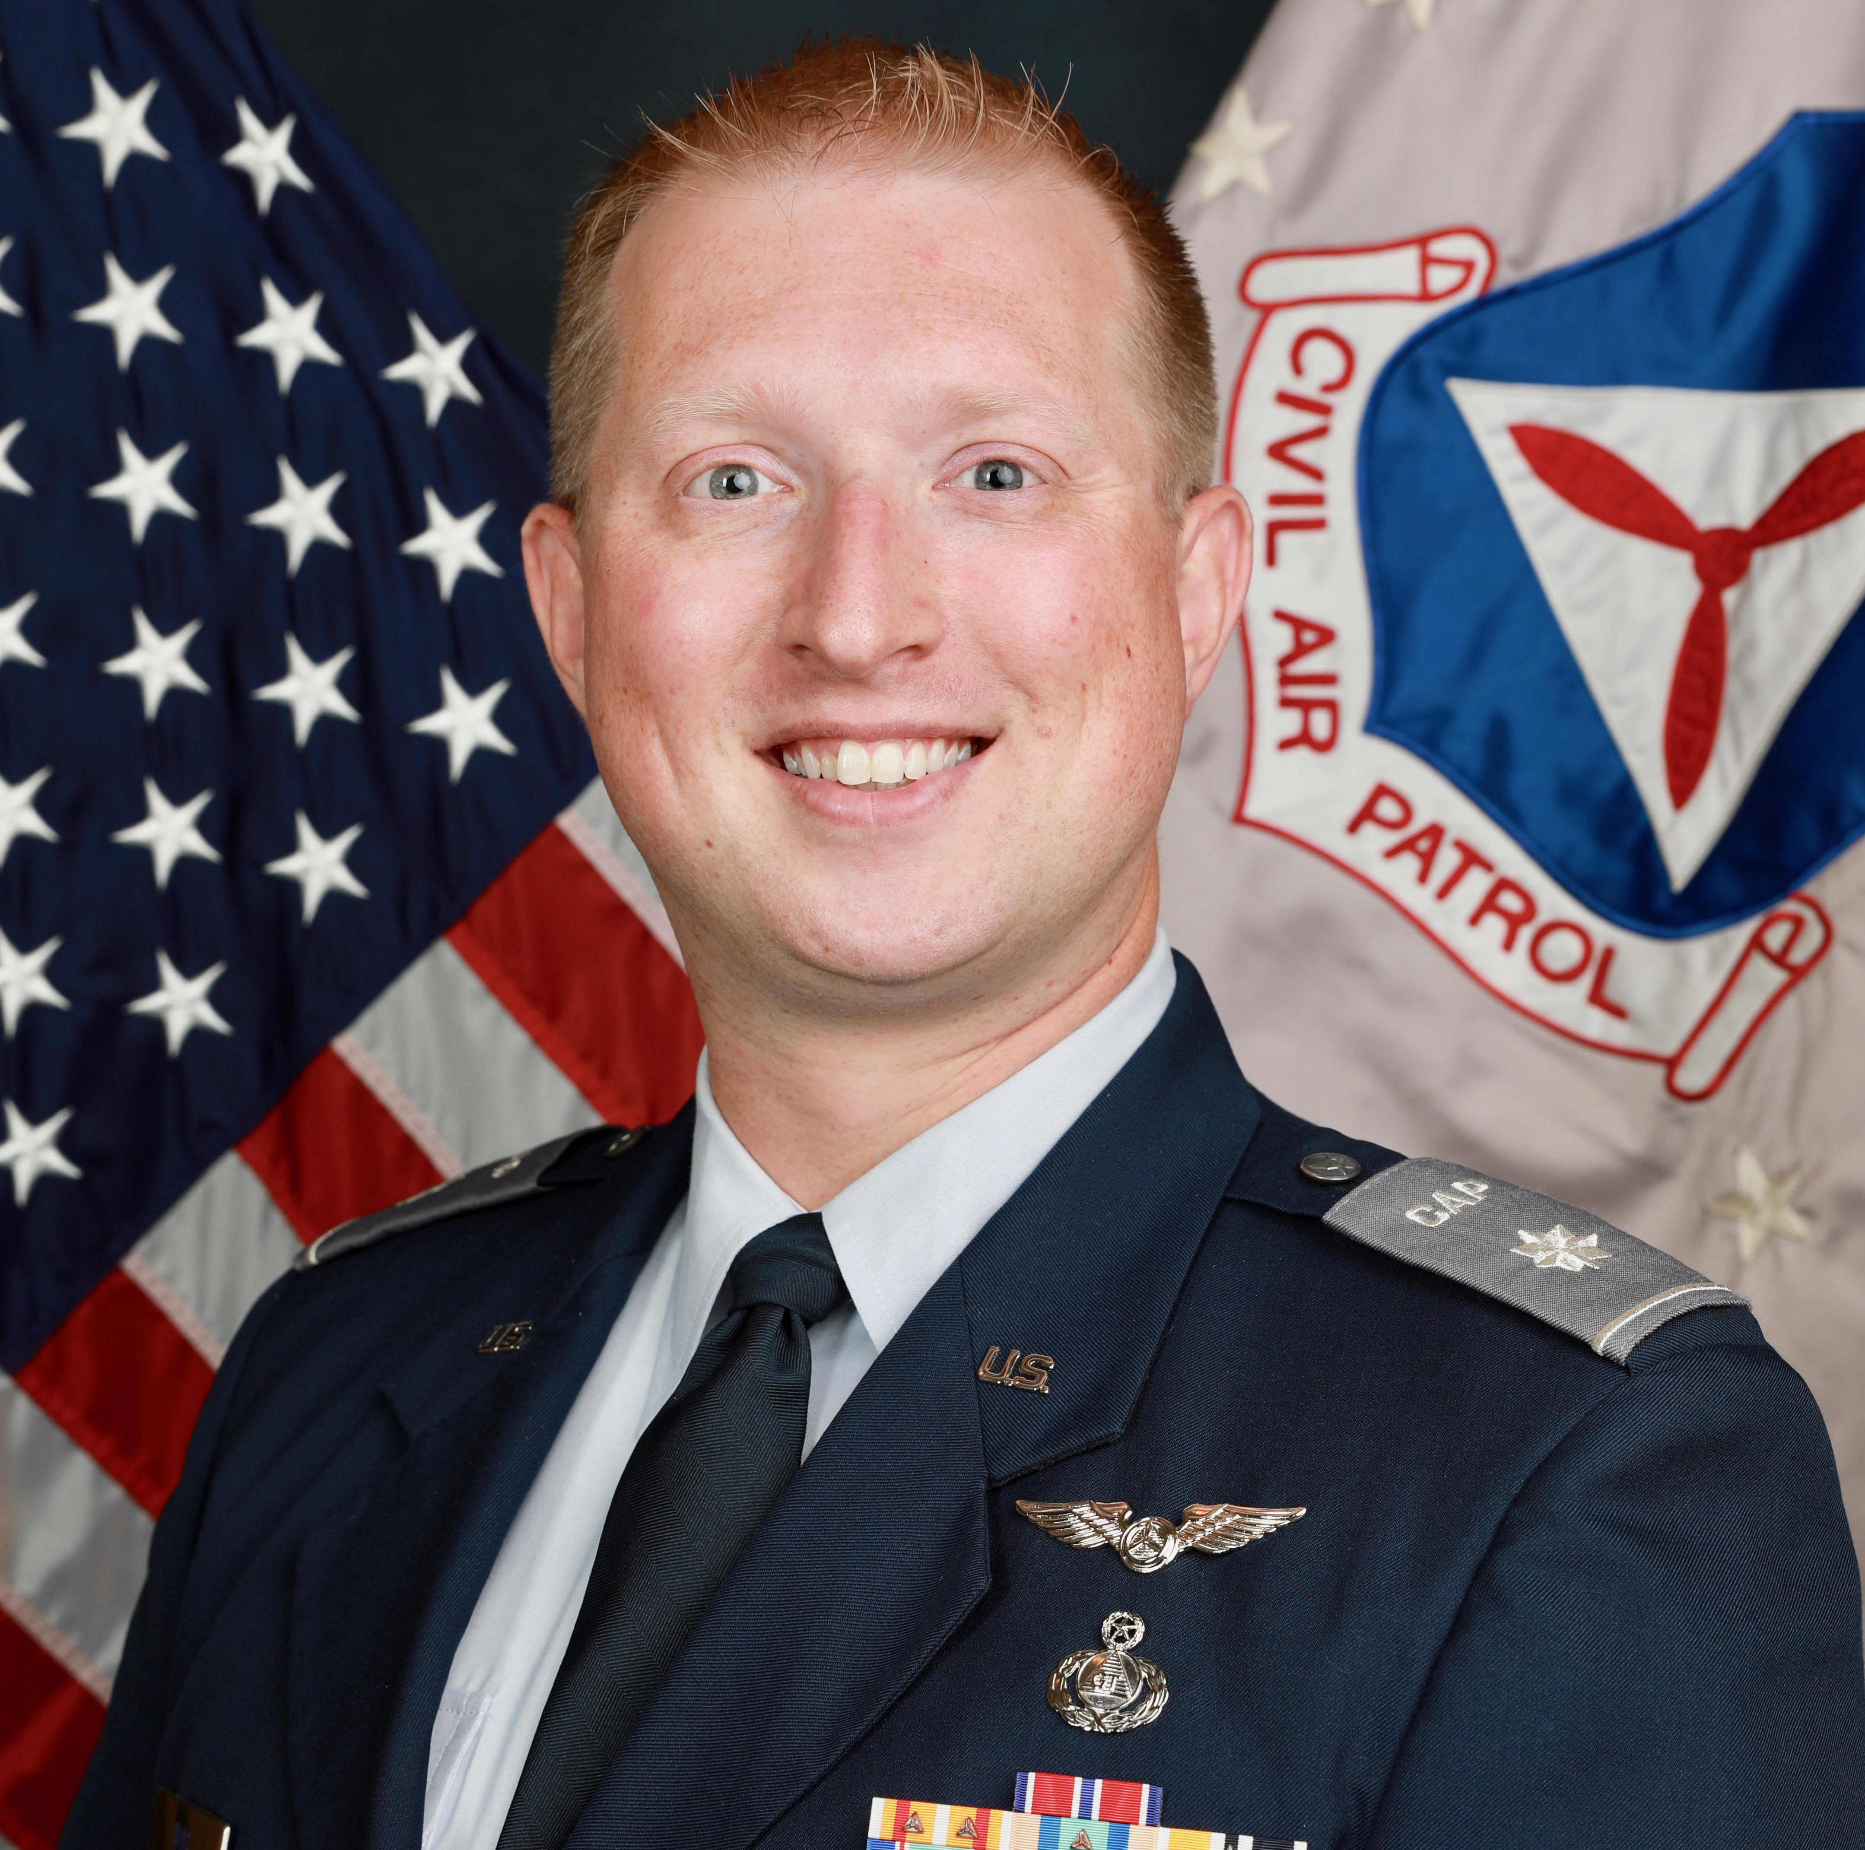
Welcome
Col Darin Ninness
Maj Michael Moore
Lt Col Edward Bos
NHWG/CC
CAP Recruiting Manager Emeritus
CAP Recruiting Manager
Former WAWG Recruiting Manager
ORWG/IG
Professional recruiting experience

Slide 3
Overview
Week 1
Week 2
Week 3
Beginning with 'Why?’
The Evolution of CAP Culture
Moving Onto How
CAP Job Description(s)
CAP Specialty Track Progression
Why Goal-Setting Matters
Annual Planning Activity for Recruiting
What Prospecting is, and How to Do it.
What is Cohort Recruiting
Steps & Best Practices
Tie-Ins with Other Directorates
Planning Activity
What is Year-Round Recruiting
Steps and Best Practices
Mentoring and Why it's Vital
Incentivizing Recruiting by Unit Members
Recruiting Skills
Sales Training Basics
Role Playing Exercise
Resources for Additional Training
Online
In-Person
Starting New Units
How it Benefits Existing Units
How it Benefits the Wing and the Corporation
Tactics, Techniques, and Procedures

Slide 5
Recruiting Skills

Slide 6
Let’s Discuss Fundamentals
Planning
Covered in Previous Session
Prospecting
Covered in Previous Session
Sales Training
Approach
Up-Front Contracts
Pain Points
The Close
Leveraging Networks
Follow-Up

Slide 7
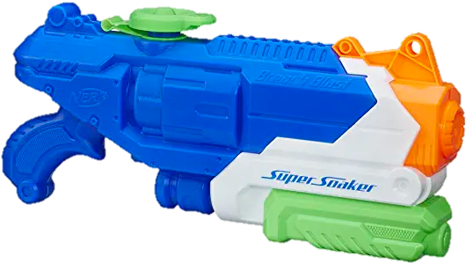
Effective Range
Super Soaker
11.5 m
ICBM
5,500 km
Trebuchet
300 m
Recruiter
1 m

Slide 8
Approach
Your initial approach matters
Phone
Email
In-Person
Knowledgeable
Warm & Professional
Polished in manner & appearance
LISTEN MORE THAN YOU SPEAK

Slide 9
Up-Front Contract
Technique for starting a meeting or pitch
Prevents ambiguous endings or wasted time
Doesn’t have to be a hard sell
“When we finish here today, can we agree that we’ll both ‘XYZ.”
Example

Slide 10
Pain Points
It’s about THEIR wants and needs (you’re listening!)
Don’t inflict pain, solve it.
Ask what they know about CAP (Remember what they say!)
Identify what they are hoping to learn, or hoping to accomplish
Ask for permission to ask questions and/or brainstorm
“Would it be ok with you if I…”
Use questions to guide conversation to learn more about their needs
If appropriate, offer a solution

Slide 11
The Close
If your solution (i.e., joining CAP, hosting a unit meeting space, sponsoring a special event, making a donation, etc) makes sense, then seal the deal
Recall the up-front contract
Have the steps to move forward ready ahead of time
The Apple Store doesn’t freeze at the end of an interaction
They know their products, and they have a way to sell them to you then-and-there
They also are totally ok with you leaving without buying
Bottom-line, be ready to close, but don’t force it

Slide 12
Leveraging Networks
You’ve had a successful interaction
They joined
They determined joining wasn’t a good fit
Who else should we speak with?
Do you know someone else who would enjoy flying with us?
Do you know other students that would like to be Cadets?
Helps keep the tank full
“I’ll think about it,” is not a good outcome.
You broke the up-front contract.

Slide 13
Wrapping-Up & Following-Up
End interactions on a positive note
“We’re excited to see you at the next Open House!”
Keep doors open, don’t burn bridges
When appropriate, send a thank-you card, email, or calendar reminder
Realistically, there may be some ambiguous endings
Track your leads, prospects, and interactions with them
If someone says call back in 6 months, DO IT!
If someone says don’t call me again, keep track of them to prevent it

Slide 14
Get it?!
Time for a break.

Slide 15
Exercise Begin
Sales CALL
VFW Commander
Want to Recruit Members
Want to Meet at Hall
Want Financial Support

Slide 17
Exercise Debrief
Sales Call
What did you see?
What would you add/do differently?

Slide 18
Training Resources

Slide 19
Public Speaking Training (Not an Endorsement)
ToastMasters (Free?)
https://www.toastmasters.org/
Fearless Presentaitons ($$)
https://www.fearlesspresentations.com/

Slide 20
Sales-Specific Training (Not an Endorsement)
Alison.com Free Online Platform
https://alison.com/courses/sales
MIT Open Courseware
https://ocw.mit.edu/index.htm
Business >> Entrepreneurial Sales (15.387)
Sandler Online Library
https://www.sandler.com/video-library/

Slide 21
Other Training (Not an Endorsement)
Sandler Sales Training ($$$)
https://www.sandler.com/
Hoffman Sales Training ($$$)
https://sellhoffman.com/
BSA District Committee Training (Free)
https://my.scouting.org

Slide 22
Starting New Units

Slide 23
Why Start New Units?
Reach unserved & underserved communities
Span of Control
Chartering neighboring units helps increase awareness & engagement at existing units
Our missions demands it
We’re not a secret & need to stop acting like one!

Slide 24
Guiding Documentation
CAPR 20-3(I)
Only mentions community members asking CAP to start a unit
CAPP 226
Specifies Master-Rated Recruiting & Retention Officers, “aid in the expansion of Civil Air Patrol through the organization, guidance and assistance in the chartering of new units.”
CAPP 4 (Rescinded) How to Start a Civil Air Patrol Unit
https://www.scribd.com/document/221031541/CAPP-4-How-to-Start-CAP-Unit-10-15-1997
Notes:
Leave time for participants to answer. Record answers on whiteboard.

Slide 25
Philosophy
In Aviation
Learn to How to Fly
Build the Plane
Fly that Plane
Starting New Units
Train Prospective Cadre
Build the Squadron
Recruit Cadets
Add Seniors
Charter that New Unit

Slide 26
How to Start New Units
The way CAPP 4 said:
Non-members come to CAP
Ask the Wing Commander for a Charter
Get a “New Unit Starter Kit”
Magically, everyone is up to speed
Shortcomings
Rare to get unsolicited interest
Training requirements have increased
Expectations for support are higher
There’s no “New Unit Starter Kit”

Slide 27
How to Start New Units
Prospecting
Just like with prospecting for members, fill the pool
Unsolicited interest
Communities with VERY large squadrons
Communities that need STEM/Youth Development
Communities with interest in aviation, but where CAP isn’t engaged

Slide 28
How to Start New Units
Training
Core leaders – join and train for 12 months before Open House
Assign these leaders to nearby units for support
Level 1, UCC, TLC (minimum)
Advertising & Marketing
6 – 8 months before the Open House
Schools (Middle, High, Community Colleges, Public & Private)
Community Orgs (Rotary, Kiwanis, VFW, American Legion, etc)
Aviation Community

Slide 29
How to Start New Units
Open House
Have Cadets from nearby units assist
Cohort Recruiting & Training for Cadets
Have Saturday Events planned every month
Have mentors lined up for specific positions
Cadet Programs
ES/Flight Operations >>>>>> Get Qualification Training Started(!!)
Chaplain, HSO, Safety, etc
Start Planning 2nd Cohort (it’s only 6 months out)

Slide 30
Questions so Far?

Slide 31
In Summary
Recruiting Skills
Resources
New Units
Quiz Posted at www.GirdwoodSquadron.com
Suspense: 15 May 2020
If you have further questions:
mmoore@cap.gov
dninness@cap.gov
edward.bos@orwgcap.org

