Slide 1
Emergency Services
12 June 2020
Presented as part of the Oregon Wing
Professional Development Workshop Series

Slide 2
Welcome
Maj Frank deBros
Maj Michael Zabetakis
Lt Col Edward Bos
CAP ES Curriculum Developer
Master Rated ESO
NESA GSAR Deputy
Master Rated ESO
ORWG/IG
Master Rated ESO

Slide 3
Overview
Week 1
Week 2
Week 3
Specialty Track Overview
Position Overview
Annual Planning
Integration Across Echelons
Relationship Management
Tools & Resources
Online Systems
Emergency Services Training Overview
Event Training Plans
Process Improvement
Emergency Services Awards
Roundtable Discussion

Slide 4
Questions so Far?

Slide 5
Relationship Management

Slide 6
Let’s Discuss Fundamentals
Planning
Covered in Previous Session
Prospecting
Primary SAR/DR Organizations
Secondary SAR/DR Organizations
Customers
CAP By-Laws
Steps to Initiating a Relationship
Approach
Up-Front Contracts
Pain Points
The Close
Leveraging Networks
Follow-Up

Slide 7
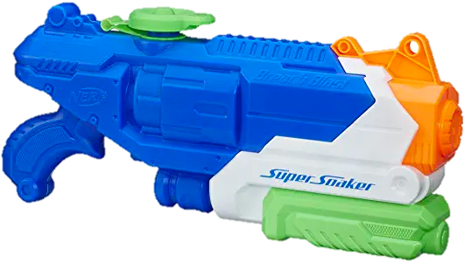
Effective Range
Super Soaker
11.5 m
ICBM
5,500 km
Trebuchet
300 m
ES Officer
1 m

Slide 8
Approach
Your initial approach matters
Phone
Email
In-Person
Knowledgeable
Warm & Professional
Polished in manner & appearance
LISTEN MORE THAN YOU SPEAK

Slide 9
Up-Front Contract
Technique for starting a meeting or pitch
Prevents ambiguous endings or wasted time
Doesn’t have to be a hard sell
“When we finish here today, can we agree that we’ll both ‘XYZ.”
Example

Slide 10
Pain Points
It’s about THEIR wants and needs (you’re listening!)
Don’t inflict pain, solve it.
Ask what they know about CAP (Remember what they say!)
Identify what they are hoping to learn, or hoping to accomplish
Ask for permission to ask questions and/or brainstorm
“Would it be ok with you if I…”
Use questions to guide conversation to learn more about their needs
If appropriate, offer a solution

Slide 11
The Close
If your solution (i.e., Aircrew Operations, Disaster Relief, Communications Capabilities, etc) makes sense, then seal the deal
Recall the up-front contract
Have the steps to move forward ready ahead of time
The Apple Store doesn’t freeze at the end of an interaction
They know their products, and they have a way to sell them to you then-and-there
They also are totally ok with you leaving without buying
Bottom-line, be ready to close, but don’t force it

Slide 12
Leveraging Networks
You’ve had a successful interaction
They want to use CAP
They determined CAP wasn’t a good fit
Who else should we speak with?
Do you know someone else who can use our support?
Helps keep the tank full
“I’ll think about it,” is not a good outcome.
You broke the up-front contract.

Slide 13
Wrapping-Up & Following-Up
End interactions on a positive note
“We’re excited to have you observe our next SAREX!”
Keep doors open, don’t burn bridges
When appropriate, send a thank-you card, email, or calendar reminder
Realistically, there may be some ambiguous endings
Track your leads, prospects, and interactions with them
If someone says call back in 6 months, DO IT!
If someone says don’t call me again, keep track of them to prevent it

Slide 14
Important Reminders
This isn’t just “Relationship Starting,” it’s “Relationship Management”
Communicate naturally, be cool, be normal
Under-Promise and Over-Deliver
Our personnel have are volunteers
If you’re unrealistic, you’ll ruin the relationship
1 bad experience can ruin years of positive interactions

Slide 15
Tools & Resources

Slide 16
Online Tools
eServices
Operations Suite
Commander’s Dashboard
Reports
WMIRS
Tracking Assets
Tracking Tracking Funds
Common Operating Picture (COP)
Let’s Look

Slide 17
Other Websites
FEMA Independent Study Courses
https://training.fema.gov/is/
Aviation Weather
https://www.aviationweather.gov/
Fire Weather & Avalanche Center
https://www.fireweatheravalanche.org/fire/
Real-Time Flight Tracking
https://www.flightradar24.com/
Flooding Forecasts
https://water.weather.gov/ahps/
All the Training!
www.youtube.com

Slide 18
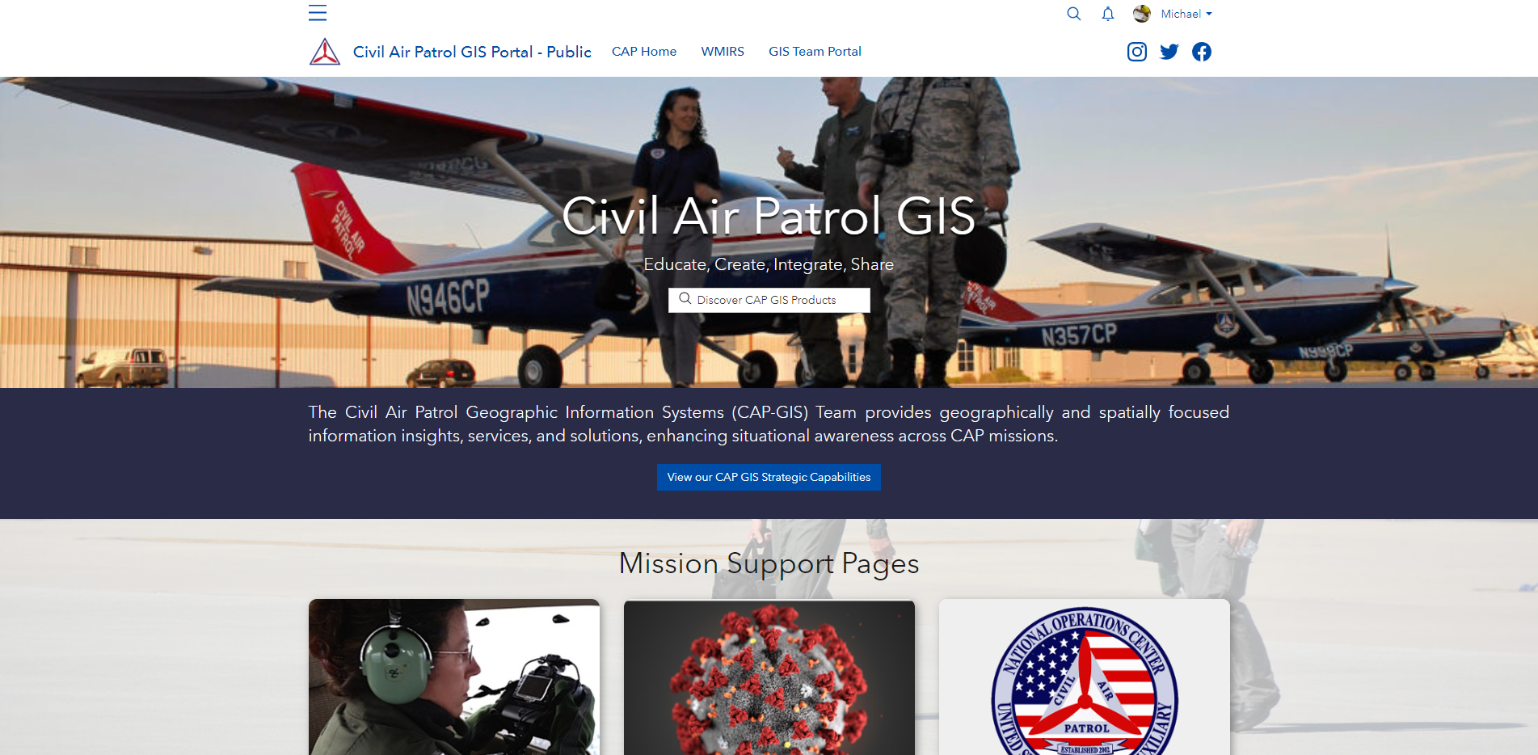
National Geographical Systems Team
Contact:
gis@cap.gov
https://public-cap-gis.hub.arcgis.com/

Slide 19
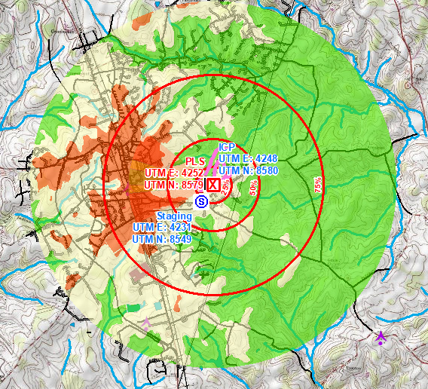
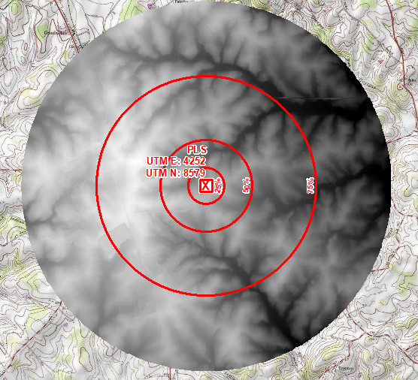
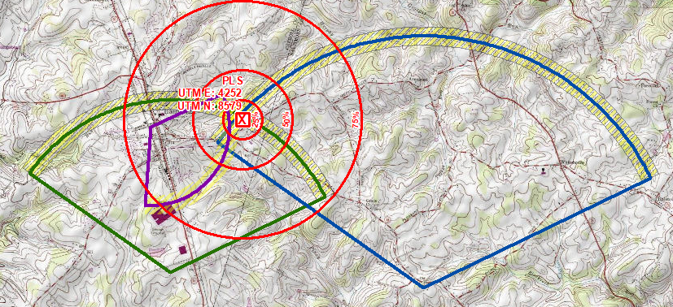
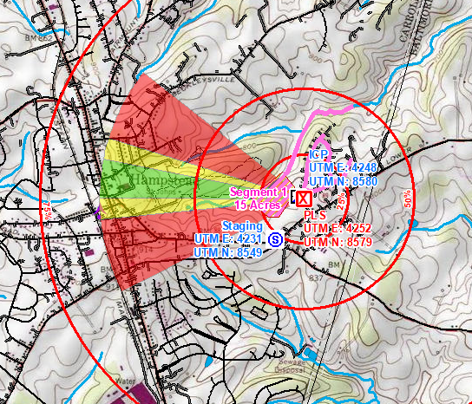
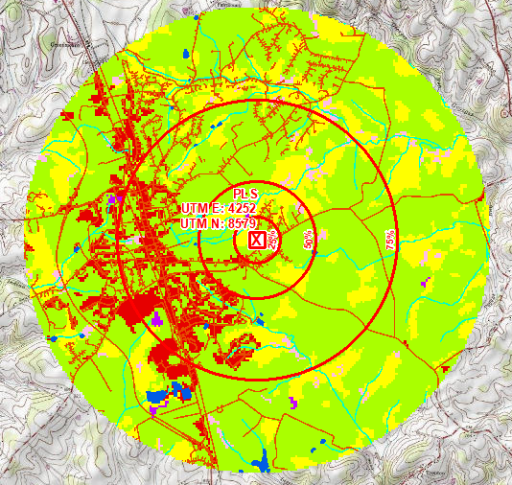
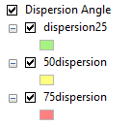
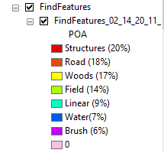
Statistical Data
Digital Elevation Model
Dispersion Model
Find Features
Elevation Change
Cellular Data

Slide 20
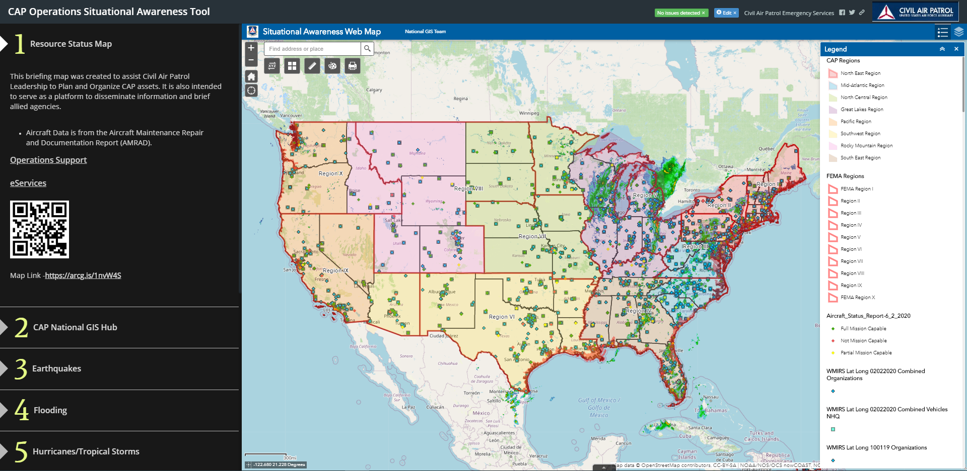
CAP Operations Situation Awareness Tool
https://arcg.is/1nvW4S

Slide 21
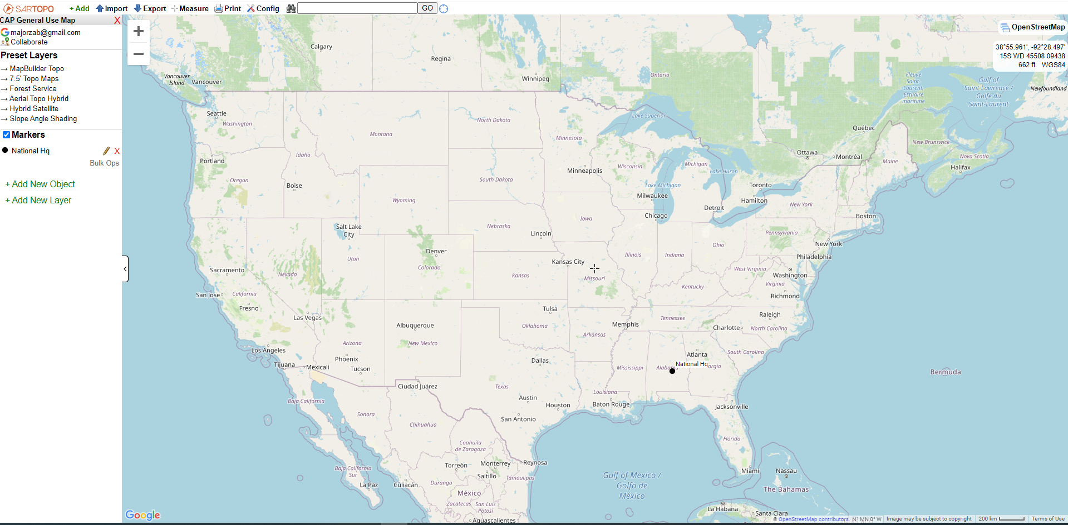
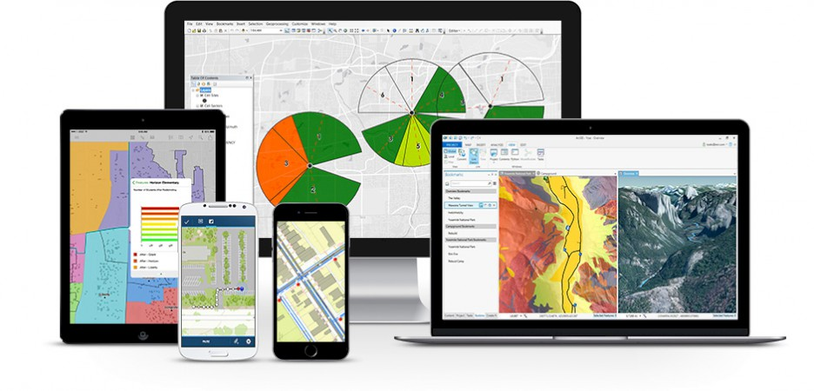
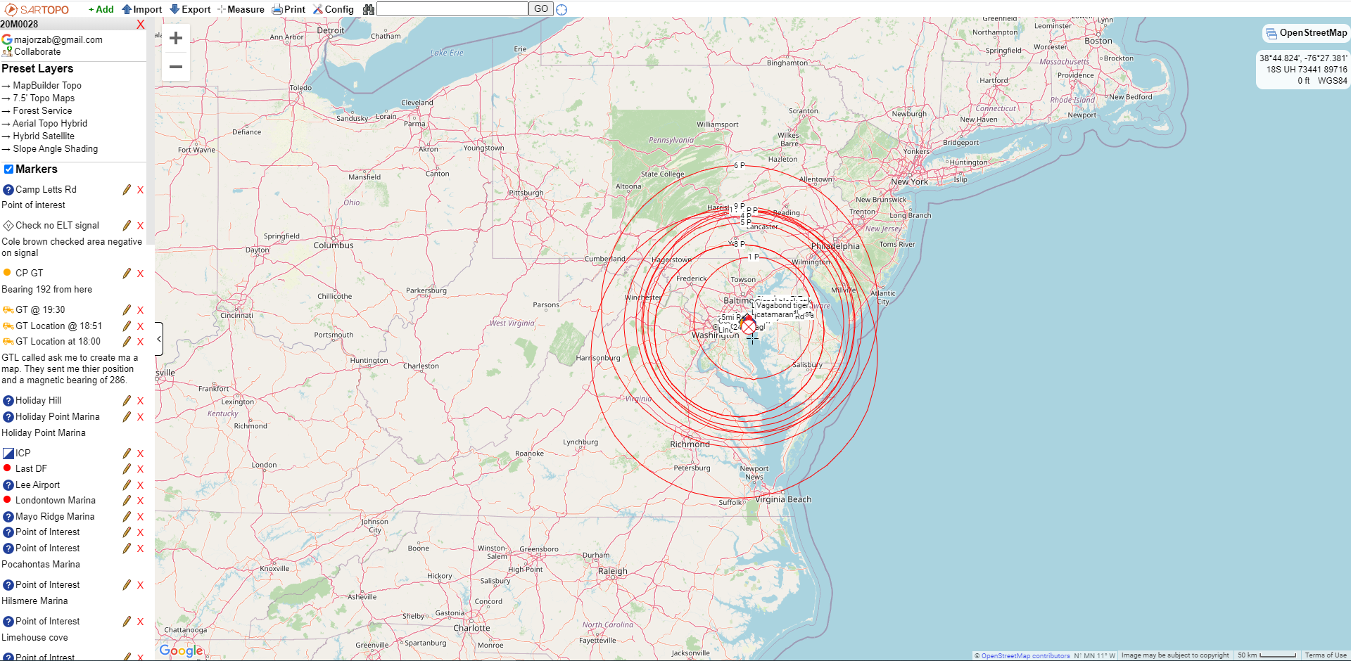
Sartopo.com and Survey123 for mission operations

Slide 22
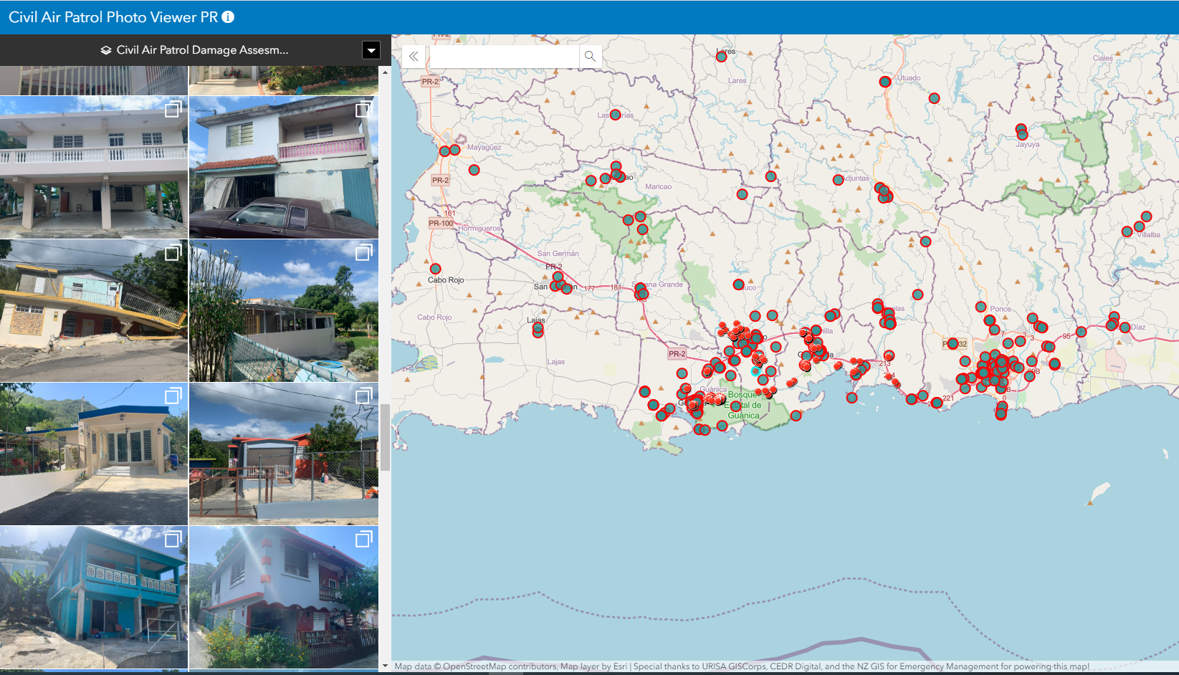
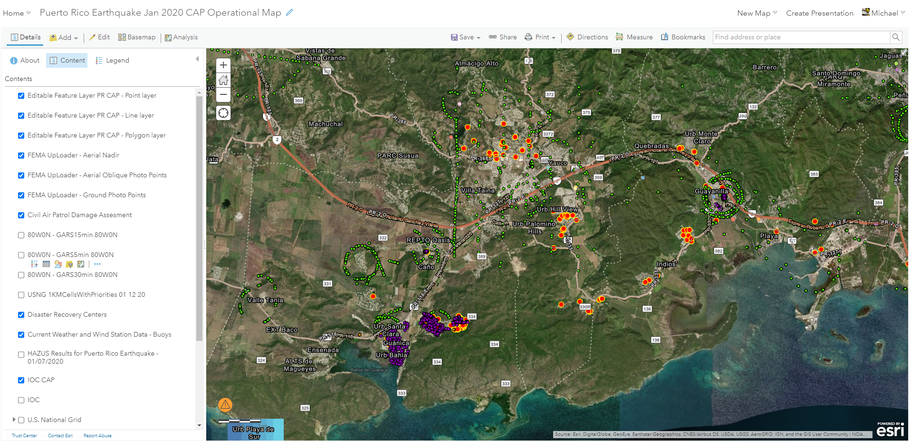
Ground Photos of Damaged Structures

Slide 23
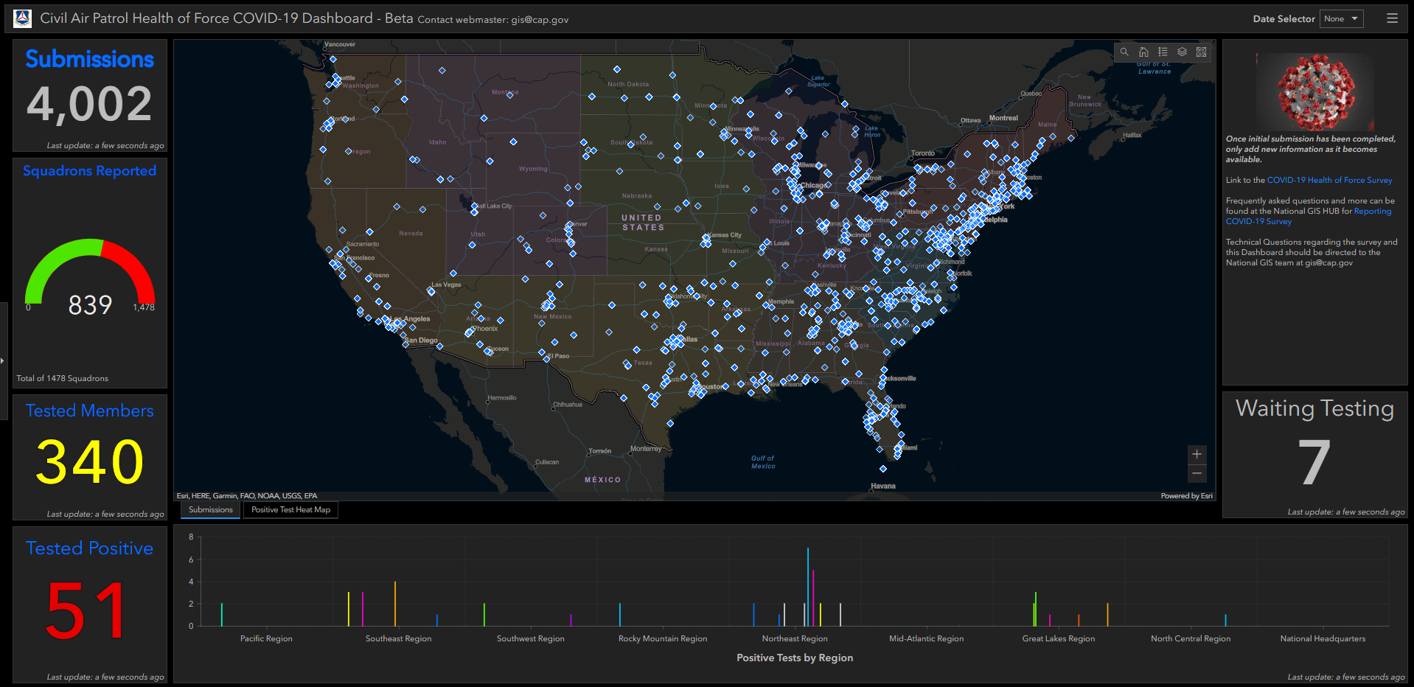
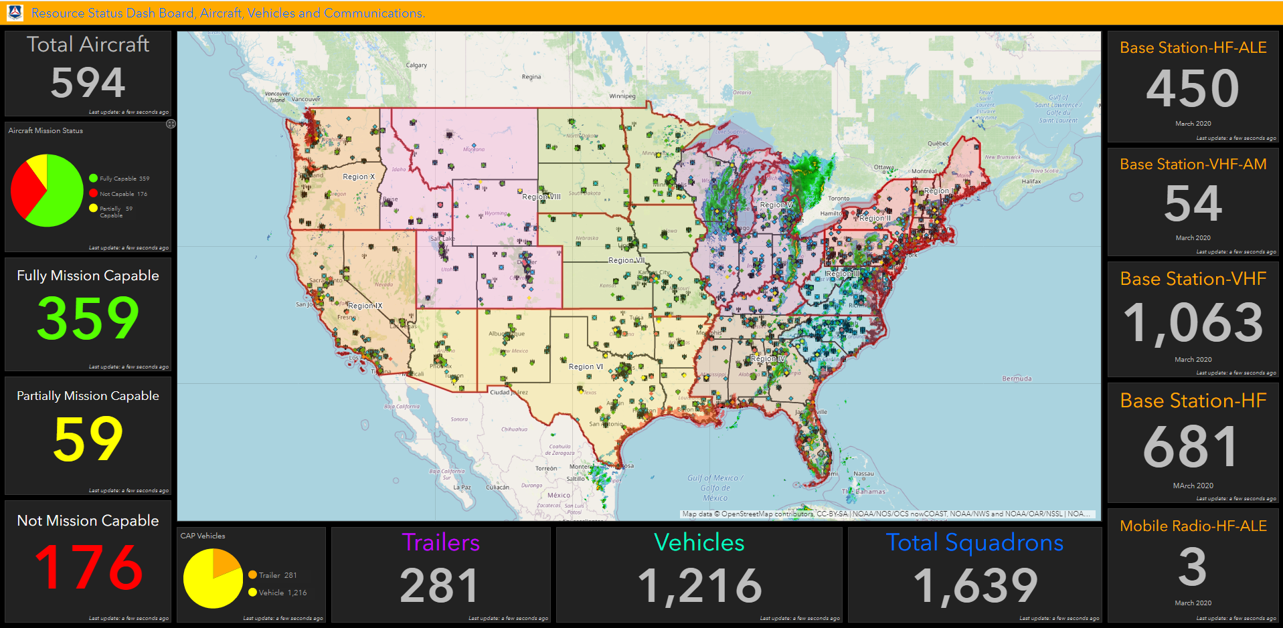
Dashboards

Slide 24
Did you know?
In Japan, broken objects are often repaired with gold.
The flaw is seen as a unique piece of the object’s history which adds to its beauty.

Slide 25
ES Training Overview

Slide 26
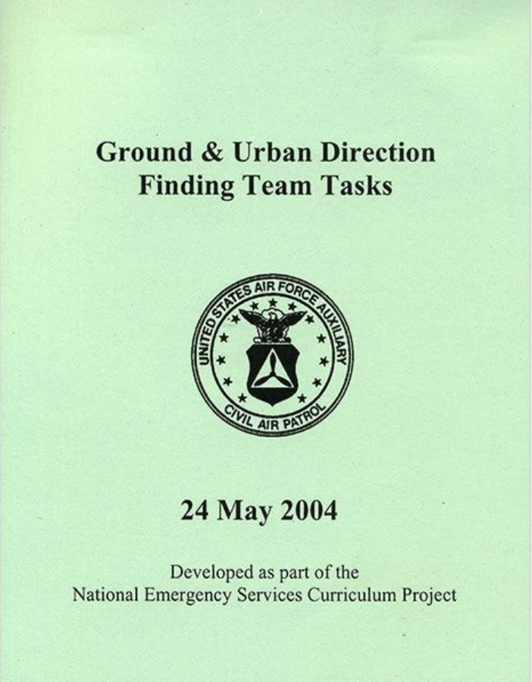
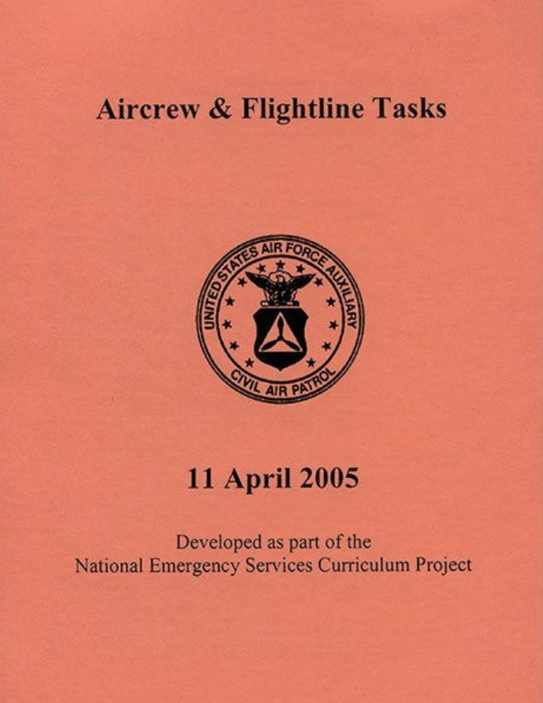
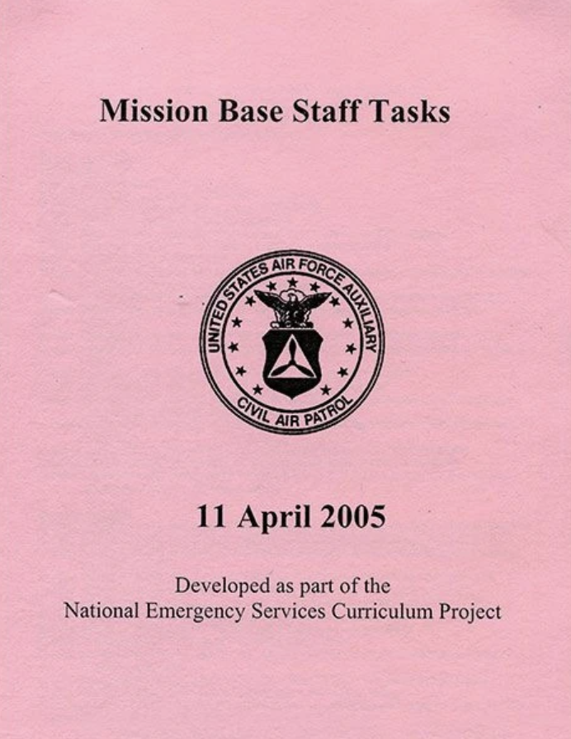
The Training System

Slide 27
Components
Specialty Qualification Training Record (SQTR)
Task Guides
Discrete Skills
Background
Performance
Field Checklists
Evaluation Criteria
Pass/Fail (Pass All Steps)
Evaluation
Qualified Evaluator
Different from Instructor (Optimal)
Tracked in eServices
Trainee or Evaluator can input
Reference Texts
Expanded & Detailed Information
NESA.CAP.GOV

Slide 28
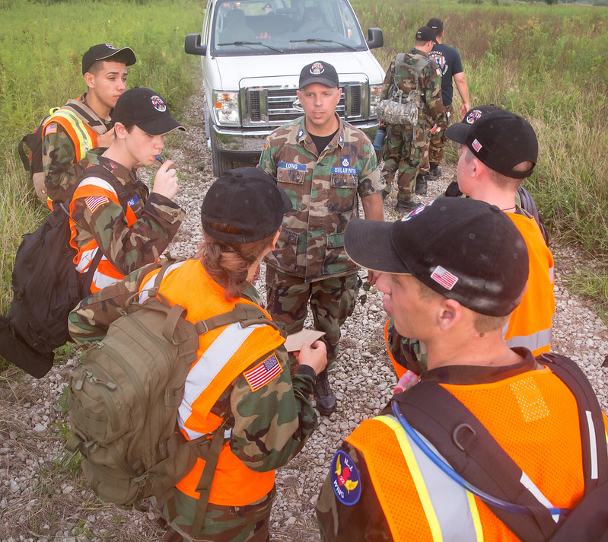
Planning a Training Event

Slide 29
Where do I start?
Talk to your members
Talk to neighboring squadrons
Identify tasks
Identify cadre
Identify location
Identify resources
Have a plan
Get permission from higher

Slide 30
Know the task(s)
Identify the tasks you want to cover
What task(s) do people need/want?
What instructors do you have?
Can you get the resources?
What other training has been done/will be done?
Study the task guide/reference text
Know evaluation requirements
Know resources needed
Talk to trained members for advice
DO NOT OVERCOMMIT!
It will always take more time/resources than you think
If you can only do one small task, that’s OK!

Slide 31
Build a cadre
Talk to trained members within your squadron/neighboring squadrons
Attend group/wing ES training to network
Talk to group/wing ES staff for help identifying members
Ensure members are trained/qualified for what you want to train
Ensure you account for CPP
Ask very nicely

Slide 32
Find a location
Know what kind of space your task(s) require
Talk to squadrons with large footprints
Public parks/campgrounds
Member “connections” (teacher at a school, conference rooms at work, sports coach, etc.)
MAKE SURE YOU HAVE PERMISSION!
Make sure the location is safe for the applicable tasks
Consider
Bathrooms
Parking
Access to food
Shelter from weather
Table space
Sufficient open space for practical tasks
“Optics”

Slide 33
Acquire resources
Use task guide as reference
Wing ES might have access to equipment that you need
Talk to other members/group/wing
This may cost money
Distribute amongst cadre
Distribute amongst attendees

Slide 34
Have a plan
Build a schedule (and stick to it!)
Plan breaks
Consider what to do if a lot (or not many) people show up
Plan meals
Is it more efficient to ”cater”?
Consider lodging for overnight training
This adds exponential complexity
Now you REALLY need to account for CPP

Slide 35
Execute
Stick to the plan as much as you can
Be flexible when you can’t
"No plan of operations extends with certainty beyond the first encounter with the enemy's main strength "
- Helmuth von Moltke the Elder
Make sure people get credit
Complete participation letters
Complete SQTR updates
Have fun!
This is what gets people to come back
"Semper Gumby "
- Unknown, but Awesome

Slide 36
A Word on Tabletop Exercises
Useful for foul-weather, end of fiscal year, or other limiting factors
Take it Seriously
Train HARDER than you expect to fight
Incorporate new personnel
Stakes are lower (not burning AVGAS), so take appropriate risks
Have a dedicated “White Cell”
Observations
Exercise Injects
Feedback

Slide 37
In Summary
Relationship Management
Tools & Resources
ES Training Overview
Part 3 continues on 19 June 2020
2100 - 2230 hrs EDT
1800 - 1930 hrs PDT
0100 - 0230 hrs UTC (20 June 2020)
Until then, if you have further questions:
mzabetakis@nesa.cap.gov
frank.debros@gmail.com
edward.bos@orwgcap.org

