Slide 1
Emergency Services
19 June 2020
Presented as part of the Oregon Wing
Professional Development Workshop Series

Slide 2
Welcome
Maj Frank deBros
Maj Michael Zabetakis
Lt Col Edward Bos
CAP ES Curriculum Developer
Master Rated ESO
NESA GSAR Deputy
Master Rated ESO
ORWG/IG
Master Rated ESO

Slide 3
Overview
Week 1
Week 2
Week 3
Specialty Track Overview
Position Overview
Annual Planning
Integration Across Echelons
Relationship Management
Tools & Resources
Online Systems
Emergency Services Training Overview
Event Training Plans
Process Improvement
Emergency Services Awards
Roundtable Discussion

Slide 4
Questions so Far?

Slide 5
EVENT TRAINING PLANS

Slide 6
Types of Events
Single-Day Training & Evaluation Event
Single-Overnight Bivouac
Wing Multi-Qualification Academy
Single ES Lesson at Unit Meeting
Multi-Weekend Training Series
Multi-Region Operations Evaluation
LESS COMPLEX MORE COMPLEX

Slide 7
Review of Planning Materials
Provided for Review
Schedule
Training Plan
Budget
Also Consider
Personnel Applications
Staff
Student
Operations Plans
Staff
Students

Slide 8
A Note on Exercise Management
DOS &/or DOST
In charge of planning
Commander &/or Incident Commander
In charge of overall execution
Control Cell
Oversees training evolutions
Coordinates injects & exercise scenario
Adds realism
Adds formal observation & feedback, outside of trainees and supervisors
CAP doesn’t have a training process
Consider skills training outside of CAP
Improv
Dungeon Master
Exercise Planning (like FEMA)

Slide 9
Tie-Ins with Other Directorates
Command Team
Guidance
Approval
Administration
Processing Applications
In processing
Participation Letters
Finance
Printing
Location Costs
Supply Costs
Cadet Programs
Marketing to Cadets
Cadet ESO
Support for Events
Public Affairs
Marketing
Safety
Safety Planning
Health Services
Medical Planning

Slide 10
PROCESS IMPROVEMENT

Slide 11
Why Improve?
Thoughts?
Makes the job easier
Accomplished the mission more effectively
Uses fewer resources
Operationalizes the Core Values
Plan, Do, Check, Act

Slide 12
AKA the Deming Cycle

Slide 13
Plan, Do, Check, Act
Plan
Annual Plan
SAREX Plan
Annual Awards Plan
Do
Execute that plan
Gather data as you go
Results
Problems/Opportunities
Anything Quantifiable

Slide 14
Plan, Do, Check, Act
Check
Evaluate those data - charts are helpful
Compare to desired results (Example: gap analysis/Appraisals)
Compare to previous cycles
Act (AKA “Adjust”
Records from the "do" and "check" identify “issues”
Issues may include:
Problems
Non-conformities,
Improvement opportunities
inefficiencies
Less-than-optimal outcomes

Slide 15
Plan, Do, Check, Act
Act (continued)
Root causes of such issues are investigated, found and eliminated by modifying the process
Risk is re-evaluated
At the end of the Act phase
The process has better instructions, standards or goals
Planning for the next cycle can proceed with a better base-line
Previous issues will be avoided
If not, then the action was not effective

Slide 16
PDCA Scenario
Annual SARCOMP
Plan
Schedule
Budget
Staffing
Marketing
Administration
Execution
Do the plan & track
Roses & Thorns
Budget
Personnel
Feedback
Check
Formal or Informal?
Act
Set the new standard [IMPROVED!!]

Slide 17
EMERGENCY SERVICES AWARDS

Slide 18
ES Awards in General
“…Of the Year”
Ribbons/Medals
Qualification Insignia
Colonel Edwin W. Lewis, Jr. Incident Staff Member of the Year Award
Colonel Dion E. DeCamp Ground Team of the Year Award
Norm Edwards Counterdrug Officer of the Year Award
Col David Kantor Operations Staff Officer of the Year Award
Lt Col T. Keith Riddle Aircrew Member of the Year Award
Search “Find” Ribbon
Air Search and Rescue Ribbon
Counterdrug Ribbon
Disaster Relief Ribbon
Homeland Security Ribbon
Certificate for Lifesaving
CAP Emergency Services Patch
ARCHER Patch
Critical Incident Stress Management (CISM) Patch
Cardiopulmonary Resuscitation (CPR) Patch
Incident Commander Badge
Observer Wings
Aircrew Wings
Ground Team Badge

Slide 19
“…of the Year” Awards Criteria
CAP Members significantly to the success of CAP’s emergency services and operational mission in the relevant category
The selection is based on the member’s life-time contributions to CAP, not just the member’s accomplishments during the year of nomination
Nominations should focus on recent participation and current benefits.
Nominations describing the nominee’s accomplishments and contributions will be submitted through channels in narrative form according to the timetable established
Be sure the nomination includes the following information:
qualifications and participation
impact on region/wing programs & missions and
impact on national emergency services and operations programs and missions

Slide 20
“…of the Year” Awards Timeline
By 15 January. Unit commanders will submit nominations to the wing commander for consideration.
By 15 February. Wing commanders will screen nominations from unit commanders within their wings and forward the best nominee to the region commander for consideration.
By 15 March. Region commanders will select the best of the wing nominees and forward one nomination to National Headquarters for consideration.
By 15 April. The National Awards Review Board at National Headquarters will screen nominations submitted by the region commanders and make recommendations to the National Commander.
Final selection will be made by the National Commander.
Your wing may have a different timeline, to coincide with annual conferences
Talk to your Personnel Officer

Slide 21
“…of the Year” Awards Package
No set form or package, as opposed to other awards (e.g., Cadet of the Year)
Consider Including:
One page memo, summarizing about why nominee deserves recognition
Memo of support from supervisor or higher-headquarters counterpart
Up to three additional pages of documentation that enhance the nomination package:
Relevant media coverage of nominee
Special recognition received by nominee or nominee’s unit for relevant performance
Best practice: Submit nomination using Word document format

Slide 22
Ribbons & Medals Criteria
 | Initial Criteria | Clasp | Devices | Reference
Air SAR | 10 Sorties | +10 Sorties | Prop Device for Aircrew | CAPR 39-3, Para 21.c.
Find | First Find | +1 Distress or +20 Non-Distress | Prop Device for Aircrew | CAPR 39-3, Para 21.d
Counterdrug | 10 Sorties | +10 Sorties |  | CAPR 39-3, Para 21.e
Disaster Relief | 5 Missions & 2 Courses |  |  | CAPR 39-3, Para 21.f
Disaster Relief with V | Presidentially Declared Disaster | +1 Presidentially Declared Disaster |  | CAPR 39-3, Para 21.g
Homeland Security | 10 Actual Sorties | +10 Actual Sorties |  | CAPR 39-3, Para 21.c
Certificate for Lifesaving | Save | +1 Save | Silver Star for non-blood/organ-transport | CAPR 39-3, Para 9.h.

Slide 23
Ribbons & Medals Process
 | Primary Document | Supporting Document | Approval Authority | Window for Award
Air SAR | CAPF 2A | Participation Letter or Mission Documentation | Wing/CC or Designee | Within 2 Years of Act
Find | CAPF 2A | Participation Letter & Award of Find Credit | Wing/CC or Designee | Within 2 Years of Act
Counterdrug | CAPF 2A | Participation Letter or Mission Documentation | Wing/CC or Designee | Within 2 Years of Act
Disaster Relief | CAPF 2A | Participation Letter or Mission Documentation | Wing/CC or Designee | Within 2 Years of Act
Disaster Relief with V | CAPF 2A | Participation Letter or Mission Documentation | Wing/CC or Designee | Within 2 Years of Act
Homeland Security | CAPF 2A | Participation Letter or Mission Documentation | Wing/CC or Designee | Within 2 Years of Act
Certificate for Lifesaving | CAPF 120 | Justification with detailed narrative | Wing/CC | Within 2 Years of Act

Slide 24
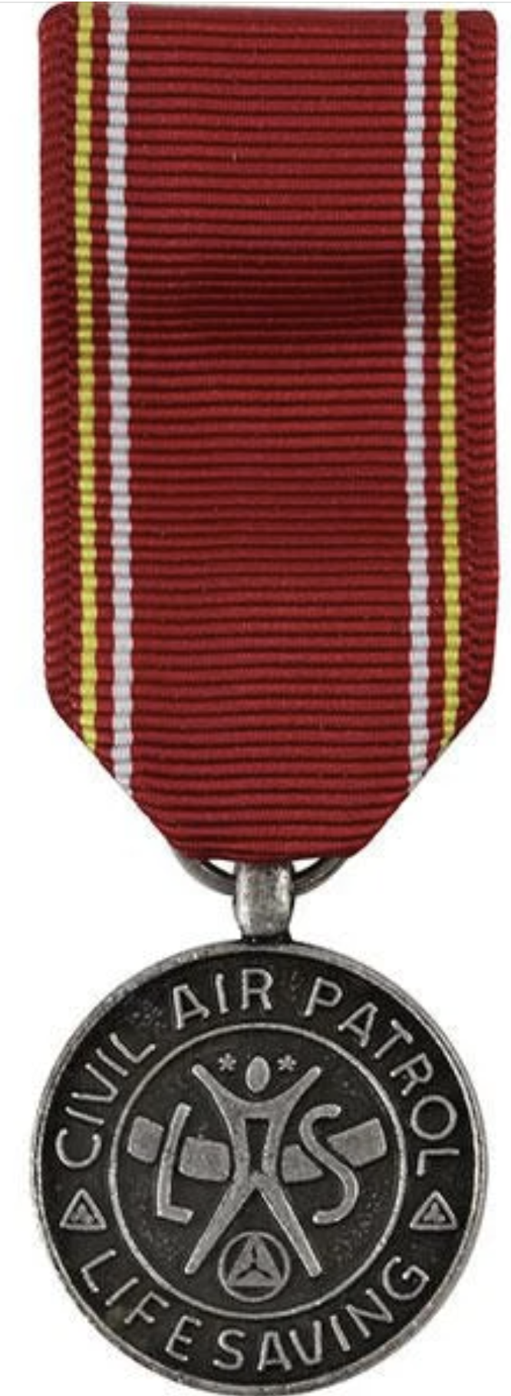
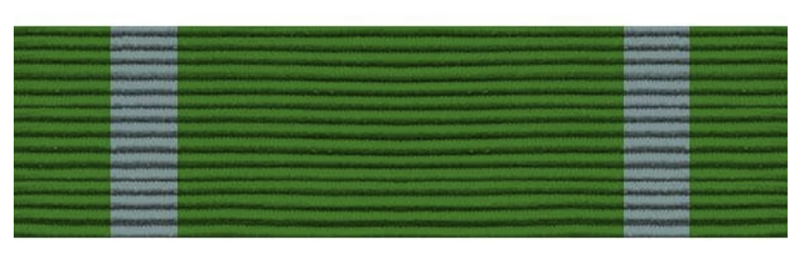
Visual Aid
Air Search & Rescue
Search “Find”
Disaster Relief
Disaster Relief w/ Valor
Certificate of Lifesaving
Homeland Security
Counterdrug (Special Air Mission)

Slide 25
Also Consider
Silver Award of Valor
Bronze Award of Valor
Distinguished Service Award
Exceptional Service Award
Meritorious Service Award
Commander’s Commendation
Achievement Award
Certificate of Appreciation
Anyone can nominate
Recognition vital for retention
Awards = Part of the Payoff

Slide 26
Qualification Insignia Criteria
 | Basic | Senior | Master
Observer Wings | MO SQTR Complete | 3+ yrs & 100+ Obs. hrs | + 2 yrs, +20 sorties (Sr), & 200+ hrs
Aircrew Wings | MS/AP/ADIS/HRO/etc SQTR Complete | Qual. above MS, 3+ yrs & 100+ Aircrew hrs | 5+ MS yrs, 200+ hrs, & 20+ actual sorties above scanner
ES Qualification Badge (Seniors) | Technician Rating Awarded | Senior Rating Awarded | Master Rating Awarded
EQ Qualification Badge (Cadets) | Technician Checklist Complete | N/A | N/A
Ground Team Badge | GTM3 SQTR Complete | GTL or GTM1 SQTR Complete | GBD SQTR Complete
Incident Commander Badge | IC3 SQTR Complete | IC2 SQTR Complete | IC1 SQTR Complete
ES Patch | GES SQTR Complete + 1 additional qual. | Can be MSA, MS, UDF, GTM3, MRO, FLM, TMP, CERT, etc.
Help Members Keep a Logbook
Prepare and Handoff Participation Letters

Slide 27
Qualification Insignia Timeline
As soon as someone is qualified
eServices > OpsQuals > Ratings, Awards & Badges
Ways to accomplish:
Member inputs, command approves
You input, command approves
You notify personnel, personnel inputs & command approves
You notify command, command inputs & approves
← Best Staff Work!

Slide 28
Visual Aid
Observer Wings
Aircrew Wings
ES Qualification Badge
Ground Team Badge
Incident Commander Badge
Emergency Services Patch

Slide 29
DISCUSSION

Slide 30
In Summary
Event Training Plans
ES Awards
Roundtable Discussion
Quiz available until 27 June 2020
www.GirdwoodSquadron.com
Afterwards, if you have further questions:
mzabetakis@nesa.cap.gov
frank.debros@gmail.com
edward.bos@orwgcap.org

