Slide 1
Improving Youth Aviation Programs
Maj Robin Kim, CAP
Standardization and Evaluation Officer
Clover Field Composite Squadron 51

Slide 2
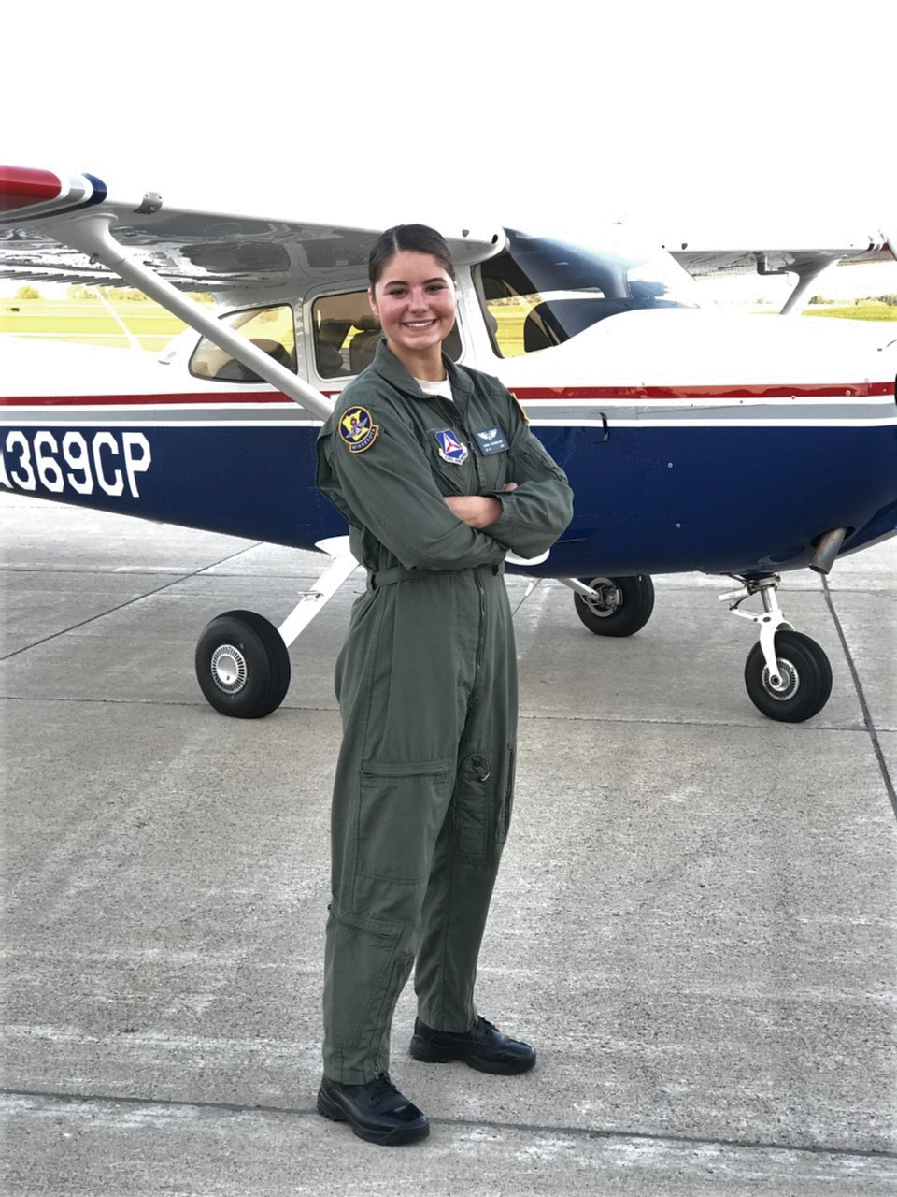
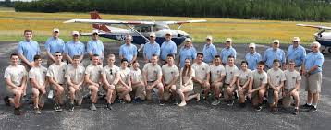
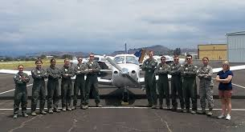
Background
Multiple Youth Aviation Initiatives and other programs
Cadet Wings, Cadet Takeoff Program, Cadet Lift, AFJROTC Flight Academy, etc.

Slide 4
Issue
Success is inconsistent
Some Wings have multiple successful cadets, others have none
MN Wing: 9 Cadet Wings Graduates
CA Wing: 0
Wing-level Staff seem unaware how to support
Operations vs Cadet Staff Experiences and Background
Unit-level and Cadets not getting the info

Slide 5
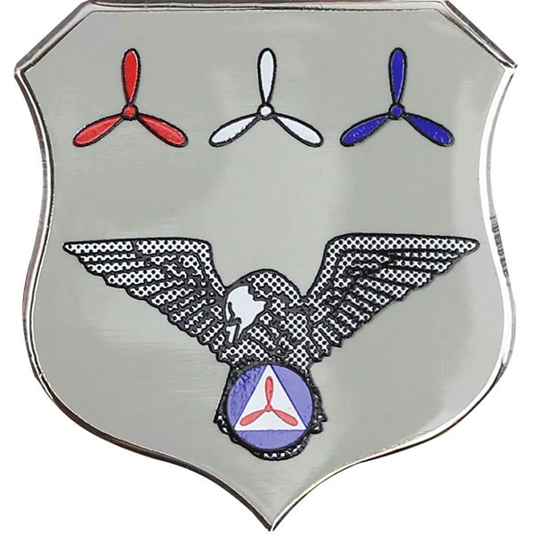
Solution
Permanent Wing-level position: Youth Aviation Officer
Currently, each Wing Commander designates a point-of-contact to NHQ
Position reports direct to Wing Commander
Wing Commander
Youth Aviation Officer

Slide 6
Youth Aviation Officer (YAO)
Permanent position elevates visibility
Ideal YAO should be available and visible to all members in Wing
Can serve as mentor for cadets in multi-year application process
Will coordinate efforts with Operations and Cadet Programs
Assistants should be appointed for larger wings
Serve as liaison to NHQ

Slide 7
Potential Implementation
Next Command Council Meeting
Present Wing Commanders with new position requirement
Give 3 months to make selection for their wing
Schedule initial online training sessions with NHQ within 2 months
Assistant YAOs appointed in larger wings
Assistant YAOs could be Cadet Pilots
Empower new YAOs to present at their next wing conference or major event
August: Command Council
November: Appoint YAO
December: Training Sessions

Slide 8
Goals
15% of cadet population in each wing should be applying for a Youth Aviation Opportunity at the end of 12 months
2% of age 17+ cadet population in each wing should be a Private Pilot at the end of 24 months
Currently, only 2.2% of cadets nationwide apply for a Youth Aviation Opportunity
Only 0.8% of cadets age 17+ are Private Pilots nationwide

Slide 9
Factors
Overseas units have unique challenges
Can appoint YAO for each nation or perhaps to the Overseas Group Commander
Constantly evolving mission needs from external partners: JROTC/ROTC/Recruiting Service/AETC
Credit for Specialty Track Duty Assignment (Operations, Stan/Eval, Cadet Programs)?

Slide 10
Questions

