Slide 1
Civil Air Patrol
Visualizing Non-Conventional Senior Member Promotions
Joshua M. Nussbaum, Capt, CAP 25 Sept 2021

Slide 2
Objectives
Plot CAPR 40-1, Attachment 2 (AKA “progression chart”) for ALL Senior Member (SM) Promotion types, not just “standard” duty performance
Draw CAPR 35-5, select Sections 3-7 graphically against Objective 1. These sections deal with promotions in:
Former CAP Cadets (Section 3)
Mission Related Skills (pilots) (Section 4)
Professional Appointments (Section 5)
Noncommissioned Officer (NCO) Appointments and Promotions (Section 6)
Flight Officer Grades (Section 7)

Slide 3
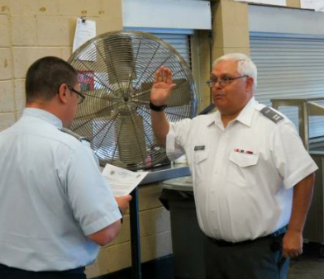
Dedication
Robert “Bob” Monnich, 1957-2019
Served as one of my mentors when I was ADY at his squadron
He was my CD when I was SQ/CC
Air Force veteran; SSgt from 1976-1993 (Electronics Technician)
“Some day, Josh, we’re gonna do our Level 5 together…”

Slide 4
WHY this project?
REGS CONFUSE PEOPLE!
Paragraphs confuse people
Charts, graphs, pictures, etc. might motivate people to pursue promotion
People remember visuals, not words

Slide 5
Scope
Originally wanted to tie promotion into retention
Determined that, due to time, data, energy, and other constraints, a longitudinal study wasn’t feasible
Was not sure when CAPR 35-5 would be updated since CAPR 40-1 was recently overhauled

Slide 6
Administrative “Issues”
Regulations say that certain echelons of commanders can grant authority, but NHQ must “click the button”
Disparities on what documentation must be submitted for each type of promotion
E-Services database doesn’t “roll over”
EX: Mitchell Cadets turning 21 must still “request” to be converted and have equivalencies granted

Slide 7
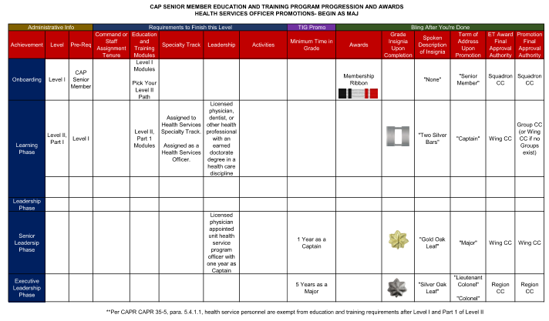
Example- AEO Begin as a Major

Slide 8
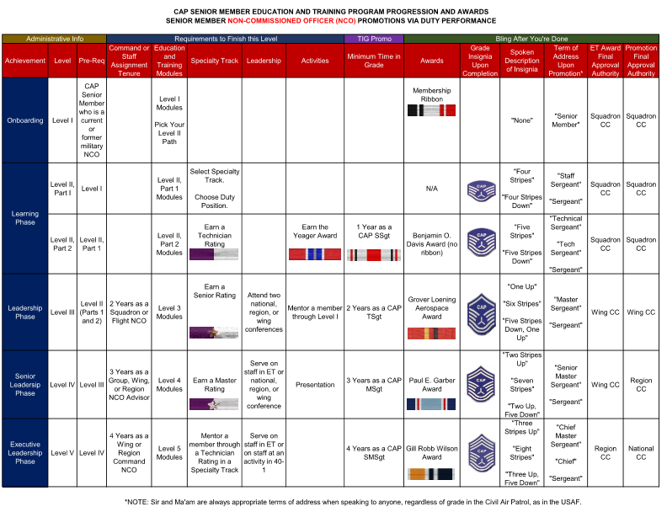
Example- NCO

Slide 9
22 Variations in total

Slide 10
Future Developments
Continue enhancing E-Services to allow local CC to approve special promotions
Add requirements to the following tracks for increasing knowledge on specialized promotions:
Administration
Cadet Programs (for Prior Cadets)
Command
Education and Training
Operations (for Mission Related)
Personnel
Provide information on higher initial appointment in onboarding

Slide 11
Questions?

