Slide 1
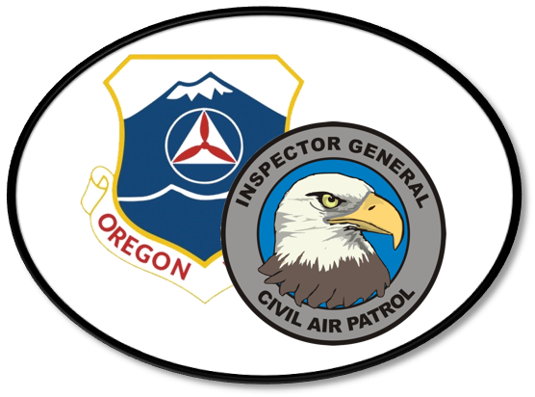
Q & A w/ ORWG/IG
Prepared for the ORWG Conference
9 April 2022

Slide 2
Welcome
Lt Col Edward A. Bos, CAP
ORWG/IG
20 Years as a CAP Senior Member (in July)
(541) 972-3449
edward.bos@orwgcap.org
Several areas with experience to share information on today…

Slide 3
Topics
Complaint Resolution | Inspections | Other Stuff
Online CAP Form 20 | SUI Preparation | IG Specialty
National Processing | SUI Teams | NESA/Emergency Services
The CR Process | Failing/Re-Inspection | Recruiting
What is Fraud, Waste, or Abuse? | Checking Units not People | Special Events
What doesn’t an IG handle? | Best Practices | CISM
 |  | Health Services

Slide 4
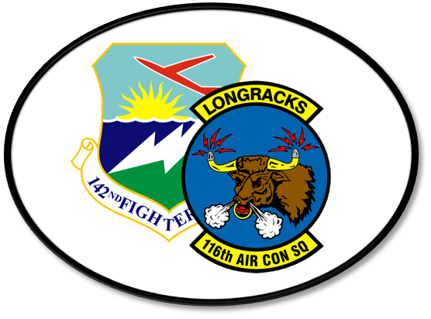
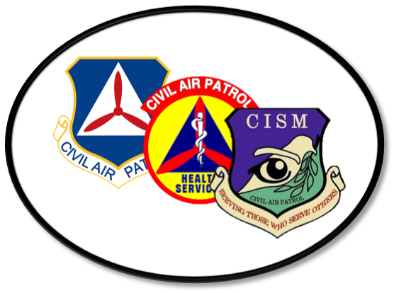
Some Details
The Oregon Wing IG
The Oregon Wing Inspector General is responsible for conducting unit inspections, advising the wing commander, supporting the wing staff and unit leaders, and serving as a local complaint resolution subject matter expert.

Slide 5
Some Details
The Oregon Wing IG
116th Air Control Squadron
The Oregon Wing Inspector General is responsible for conducting unit inspections, advising the wing commander, supporting the wing staff and unit leaders, and serving as a local complaint resolution subject matter expert.
Oregon Air National Guard's 116th Air Control Squadron (ACS), located at Camp Rilea, Warrenton, Oregon, is a deployable radar/communications unit with superior mobility and response to global and local missions.

Slide 6
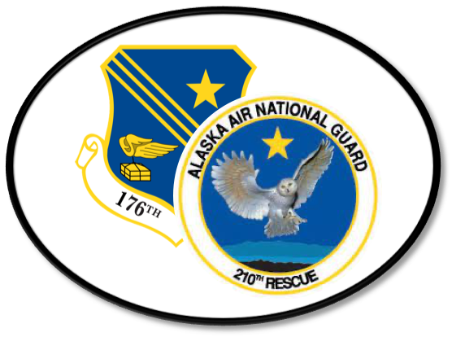
The Oregon Wing IG
116th Air Control Squadron
Psychology
The Oregon Wing Inspector General is responsible for conducting unit inspections, advising the wing commander, supporting the wing staff and unit leaders, and serving as a local complaint resolution subject matter expert.
Oregon Air National Guard's 116th Air Control Squadron (ACS), located at Camp Rilea, Warrenton, Oregon, is a deployable radar/communications unit with superior mobility and response to global and local missions.
With an B.S. in Psychology from the University of Alaska Anchorage, and a M.A. from Pacific University, Ed Bos is currently a doctoral student working on a Doctor of Psychology degree, with an emphasis in Health Psychology and an interest in primary care.

Slide 7
116th Air Control Squadron
Psychology
Health Services/CISM
Oregon Air National Guard's 116th Air Control Squadron (ACS), located at Camp Rilea, Warrenton, Oregon, is a deployable radar/communications unit with superior mobility and response to global and local missions.
With an B.S. in Psychology from the University of Alaska Anchorage, and a M.A. from Pacific University, Ed Bos is currently a doctoral student working on a Doctor of Psychology degree, with an emphasis in Health Psychology and an interest in primary care.
Service on the CAP Health Services team, and the CAP CISM program management team, including development of the Health Services Specialty Track (pending) and the shift away from ICISF training to a peer-supporter model.

Slide 8
Psychology
Health Services/CISM
210th Rescue Squadron
With an B.S. in Psychology from the University of Alaska Anchorage, and a M.A. from Pacific University, Ed Bos is currently a doctoral student working on a Doctor of Psychology degree, with an emphasis in Health Psychology and an interest in primary care.
Service on the CAP Health Services team, and the CAP CISM program management team, including development of the Health Services Specialty Track (pending) and the shift away from ICISF training to a peer-supporter model.
210th is a combat search and rescue squadron trained to locate and recover downed fighter pilots. The day-to day mission is to perform an 11th AF 24-hour Alaska Theater Search and Rescue Alert. The 210th is one of the busiest Air Force combat search and rescue squadrons in the world.

Slide 9
Health Services/CISM
210th Rescue Squadron
Senior District Executive
Service on the CAP Health Services team, and the CAP CISM program management team, including development of the Health Services Specialty Track (pending) and the shift away from ICISF training to a peer-supporter model.
210th is a combat search and rescue squadron trained to locate and recover downed fighter pilots. The day-to day mission is to perform an 11th AF 24-hour Alaska Theater Search and Rescue Alert. The 210th is one of the busiest Air Force combat search and rescue squadrons in the world.
Scouting professionals are trained to promote youth development programs, provide expert support and oversight to volunteers, manage budgets and program delivery, as well as fundraising and recruiting for sustainability.

Slide 10
210th Rescue Squadron
Senior District Executive
NHQ-007
210th is a combat search and rescue squadron trained to locate and recover downed fighter pilots. The day-to day mission is to perform an 11th AF 24-hour Alaska Theater Search and Rescue Alert. The 210th is one of the busiest Air Force combat search and rescue squadrons in the world.
Scouting professionals are trained to promote youth development programs, provide expert support and oversight to volunteers, manage budgets and program delivery, as well as fundraising and recruiting for sustainability.
The National Emergency Services Academy is not just an activity. A portion of the cadre are assigned to the NESA Squadron, with their primary membership and attention going to development and delivery of Emergency Services curriculum.

Slide 11
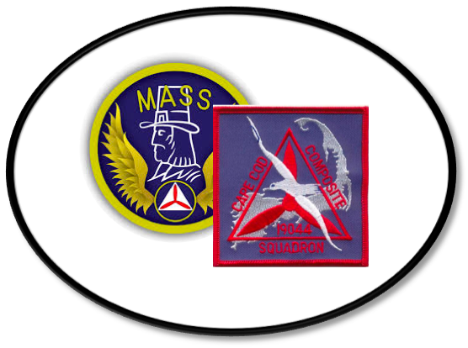
Senior District Executive
NHQ-007
Oregon JOC
Scouting professionals are trained to promote youth development programs, provide expert support and oversight to volunteers, manage budgets and program delivery, as well as fundraising and recruiting for sustainability.
The National Emergency Services Academy is not just an activity. A portion of the cadre are assigned to the NESA Squadron, with their primary membership and attention going to development and delivery of Emergency Services curriculum.
The Oregon Military Department maintains a 24-7 Joint Operations Center (JOC), with responsibilities for mission essential comms, info sharing, and maintaining situational awareness and a common operating picture for the department leadership.

Slide 12
NHQ-007
Oregon JOC
US Dept of Health & Human Services
The National Emergency Services Academy is not just an activity. A portion of the cadre are assigned to the NESA Squadron, with their primary membership and attention going to development and delivery of Emergency Services curriculum.
The Oregon Military Department maintains a 24-7 Joint Operations Center (JOC), with responsibilities for mission essential comms, info sharing, and maintaining situational awareness and a common operating picture for the department leadership.
Worked under the response operations officers for the Assistant Secretary for Preparedness and Response. Supported the federal medical stations program, deliberate planning for special events, and the Secretary's Operations Center during hurricanes Hannah, Gustav, and Ike.

Slide 13
Oregon JOC
US Dept of Health & Human Services
MA-044
The Oregon Military Department maintains a 24-7 Joint Operations Center (JOC), with responsibilities for mission essential comms, info sharing, and maintaining situational awareness and a common operating picture for the department leadership.
Worked under the response operations officers for the Assistant Secretary for Preparedness and Response. Supported the federal medical stations program, deliberate planning for special events, and the Secretary's Operations Center during hurricanes Hannah, Gustav, and Ike.
Located on the Massachusetts Military Reservation, what was formerly the Cape Cod Composite Squadron was redesignated as Coastal Patrol 18, in honor of its WWII heritage.

Slide 14
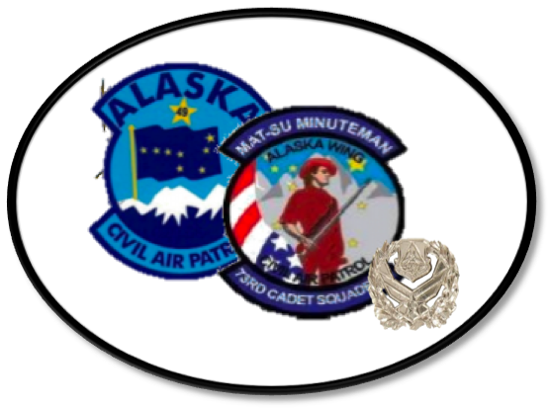
US Dept of Health & Human Services
MA-044
102d Aircraft Maintenance Squadron
Worked under the response operations officers for the Assistant Secretary for Preparedness and Response. Supported the federal medical stations program, deliberate planning for special events, and the Secretary's Operations Center during hurricanes Hannah, Gustav, and Ike.
Located on the Massachusetts Military Reservation, what was formerly the Cape Cod Composite Squadron was redesignated as Coastal Patrol 18, in honor of its WWII heritage.
Before the 2006 realignment and change of missions, Otis Air National Guard Base was home to a squadron of F-15s, defending the Northeast Air Defense Sector.

Slide 15
MA-044
102d Aircraft Maintenance Squadron
ARC Instructor
Located on the Massachusetts Military Reservation, what was formerly the Cape Cod Composite Squadron was redesignated as Coastal Patrol 18, in honor of its WWII heritage.
Before the 2006 realignment and change of missions, Otis Air National Guard Base was home to a squadron of F-15s, defending the Northeast Air Defense Sector.
In order to teach First Aid, CPR and related courses, Bos & Associates was founded to serve as the corporate body to serve as a licensed training provider.

Slide 16
102d Aircraft Maintenance Squadron
ARC Instructor
AK-073
Before the 2006 realignment and change of missions, Otis Air National Guard Base was home to a squadron of F-15s, defending the Northeast Air Defense Sector.
The Mat-Su Minuteman Cadet Squadron served the communities of Palmer and Wasilla, Alaska from 2007 to 2016.
In order to teach First Aid, CPR and related courses, Bos & Associates was founded to serve as the corporate body to serve as a licensed training provider.

Slide 17
ARC Instructor
AK-073
Inland SAR Planning Course
In order to teach First Aid, CPR and related courses, Bos & Associates was founded to serve as the corporate body to serve as a licensed training provider.
The Mat-Su Minuteman Cadet Squadron served the communities of Palmer and Wasilla, Alaska from 2007 to 2016.
The ISPC is a five day resident and exportable course designed to teach advanced search and rescue theory and its application to land and air searches for missing persons and aircraft. The target audience is SAR leaders in federal, state, and local emergency services and law enforcement.

Slide 18
AK-073
Inland SAR Planning Course
Alaska Community Share
The Mat-Su Minuteman Cadet Squadron served the communities of Palmer and Wasilla, Alaska from 2007 to 2016.
The ISPC is a five day resident and exportable course designed to teach advanced search and rescue theory and its application to land and air searches for missing persons and aircraft. The target audience is SAR leaders in federal, state, and local emergency services and law enforcement.
Alaska Community Share was a member of Community Shares USA. This represented a federation of nonprofits, primarily focused on social justice; similar to the United Way and its focus on human services.

Slide 19
Inland SAR Planning Course
Alaska Community Share
National Staff
The ISPC is a five day resident and exportable course designed to teach advanced search and rescue theory and its application to land and air searches for missing persons and aircraft. The target audience is SAR leaders in federal, state, and local emergency services and law enforcement.
Alaska Community Share was a member of Community Shares USA. This represented a federation of nonprofits, primarily focused on social justice; similar to the United Way and its focus on human services.
The Chief Operating Officer coordinates with volunteer leadership and the National Commander, or his designee, and appoints volunteer National Staff who normally function under their appointed director.

Slide 20
Alaska Community Share
National Staff
Volunteer University
Alaska Community Share was a member of Community Shares USA. This represented a federation of nonprofits, primarily focused on social justice; similar to the United Way and its focus on human services.
The Chief Operating Officer coordinates with volunteer leadership and the National Commander, or his designee, and appoints volunteer National Staff who normally function under their appointed director.
Volunteer University Instructors are approved and trained by the Volunteer University faculty to teach the five levels of the Education and Training Program.

Slide 21
National Staff
Volunteer University
The Chief Operating Officer coordinates with volunteer leadership and the National Commander, or his designee, and appoints volunteer National Staff who normally function under their appointed director.
Volunteer University Instructors are approved and trained by the Volunteer University faculty to teach the five levels of the Education and Training Program.

Slide 22
Volunteer University
Volunteer University Instructors are approved and trained by the Volunteer University faculty to teach the five levels of the Education and Training Program.

